Slide 1

Pawdopter Mobile Application, connected to IoT Home Device, for potential Animal Adopters to find their Pet to love
Paula Carine Oehme 2957903
Sarah Narayamy Tavares Silva 2960992

Slide 2
Problem Definition
The importance of relationship with pets evolved over the years;
Abandonment of animals and difficulty of finding desired pet to adopt;
According to Department of Rural and Community Development (2018), from 2010 to 2018 over 132 thousands of dogs entered pounds all over Ireland, of which more than 29 thousand were euthanized due to the inability of finding them a new home, which means an average of 21% per year;
Lack of tools and campaigns to increase the adoption rate.

Slide 3
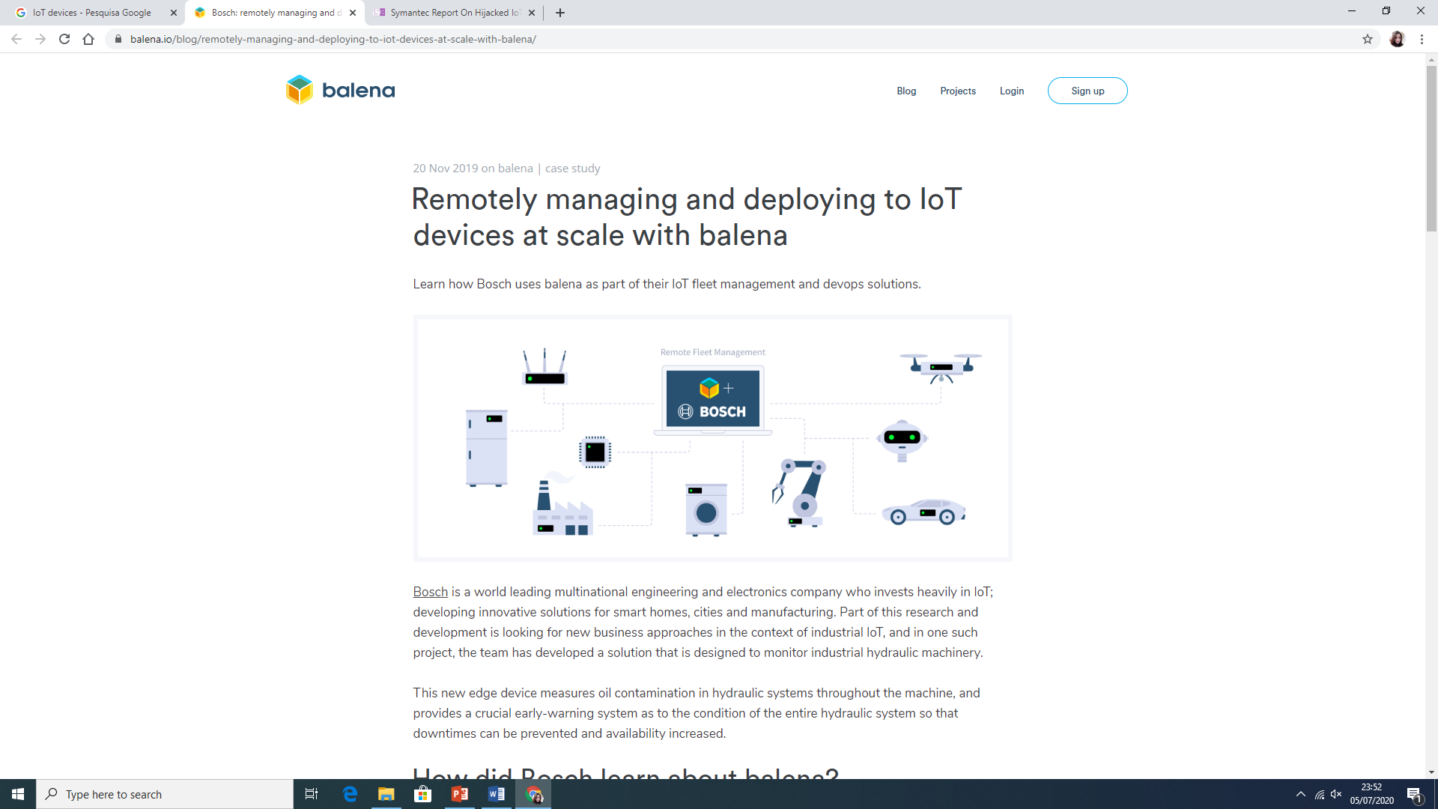
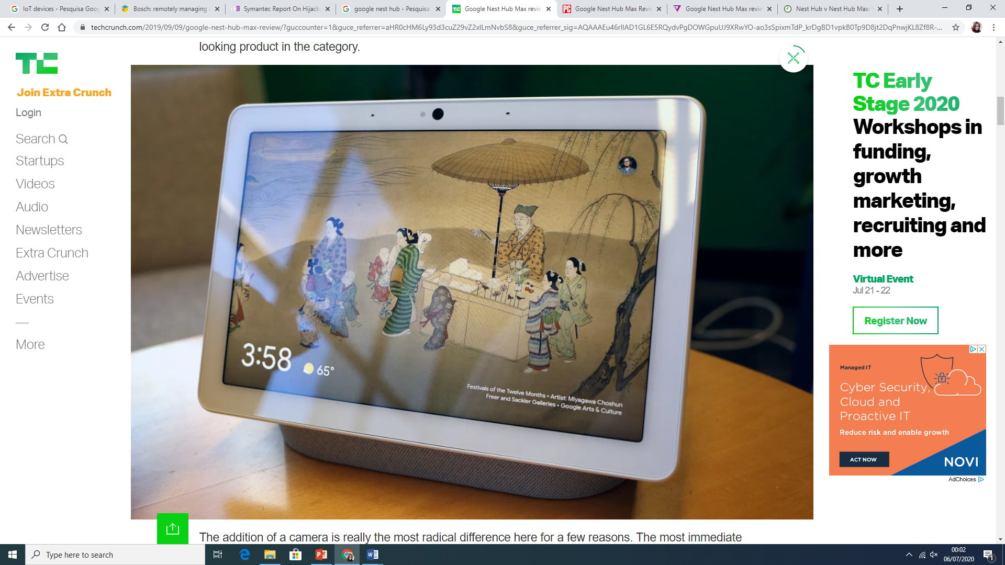
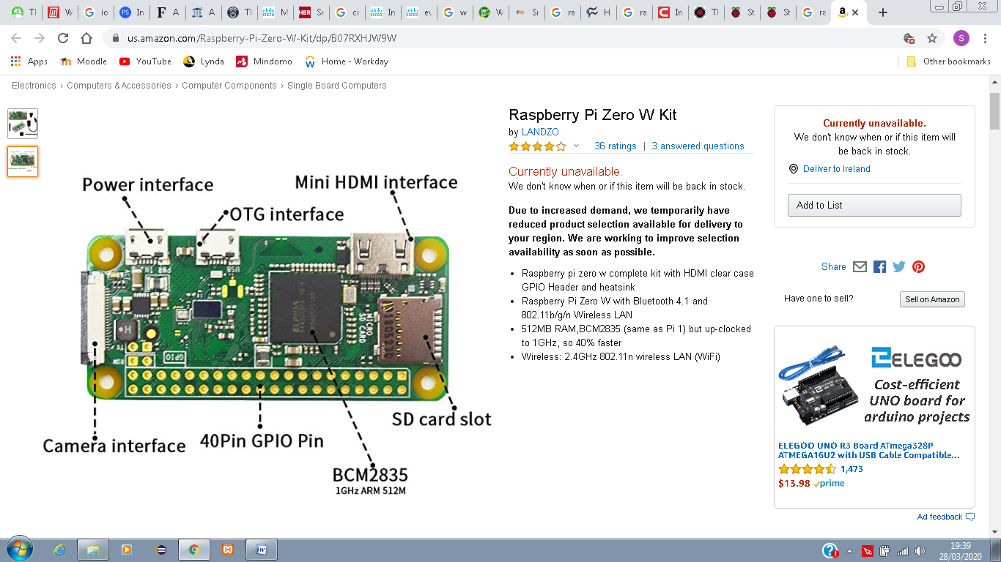
IoT – Internet of Things
Ordinary objects stops being just ordinary by adding connectedness into them
Wireless technology such as Bluetooth, RFID, Wi-Fi, sensors
Raspberry Pi/ Arduino
Google Home/ Amazon Alexa

Slide 4
Project Goal
Research in the field of animal adoption in Ireland;
Research in the use of IoT devices;
Create a mobile application with specific functionalities to facilitate finding a desired pet by potential adopters;
Integrate the mobile application with IoT Home device (Google Assistant) for easy voice command search

Slide 5
Project Scope
To create a mobile application to benefit potential adopters in their search for a pet to love;
Use of filters to find a pet with specified characteristics;
Connect the app to an IoT Home device (Google Assistant) and use voice command for easy search of a desired pet.

Slide 6
Project Objectives
Perform Literature Review on the topic;
Perform primary research, using Mixed methodology (Quantitative and Qualitative);
Prepare Conceptual model, based on the results of the Primary and Secondary research;
Design, Code, and Test the application;
Integrate the application with Google Home Assistant;
Perform User Evaluation of the developed application;
Analyse results;
Complete the Thesis and present the Project.

Slide 7
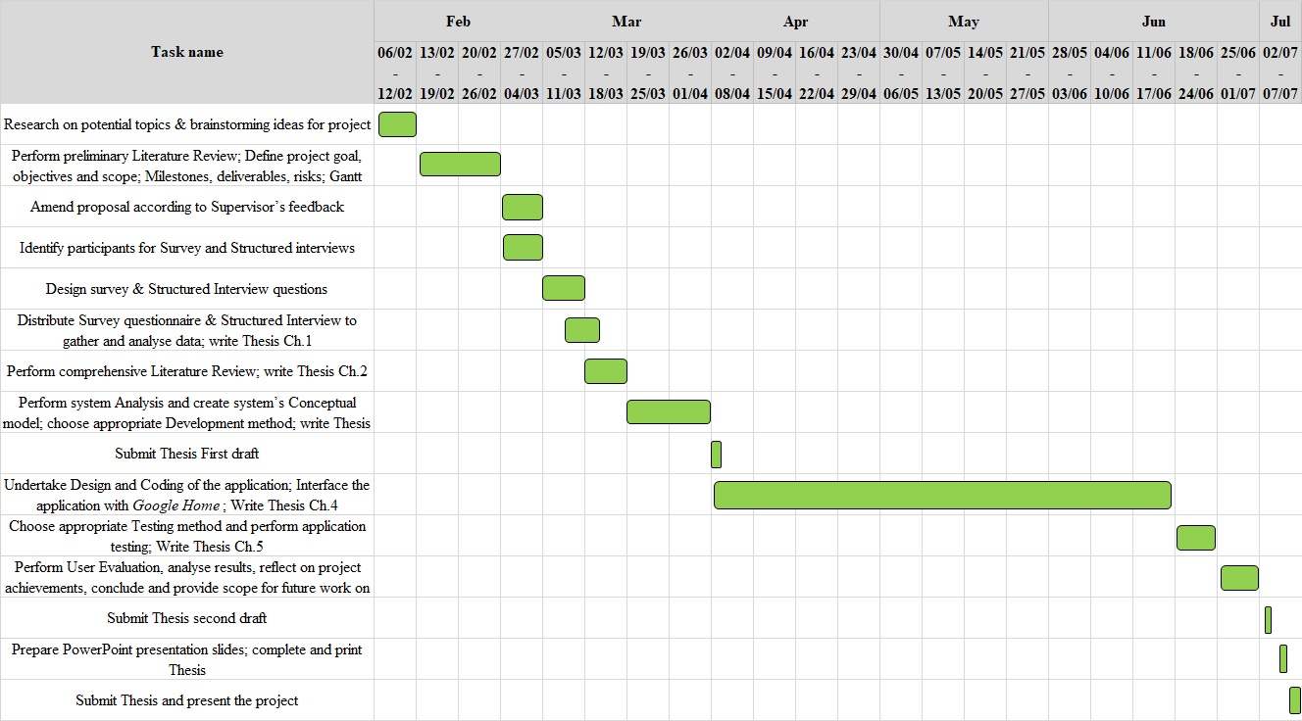
Project Gant Chart

Slide 8
Chosen Research and Development Methodologies for the project
Mixed research method:
Quantitative (Survey with potential pet adopters)
Qualitative (Structured Interview with Management of Animal Sanctuaries)
However, due to Covid-19 3 months lockdown of the country – no responses obtained from the Management staff of any of the Sanctuaries approached with Structured Interview questions)
Dynamic Software Development Method (DSDM)
Time Boxing
MoSCoW
Prototyping

Slide 9
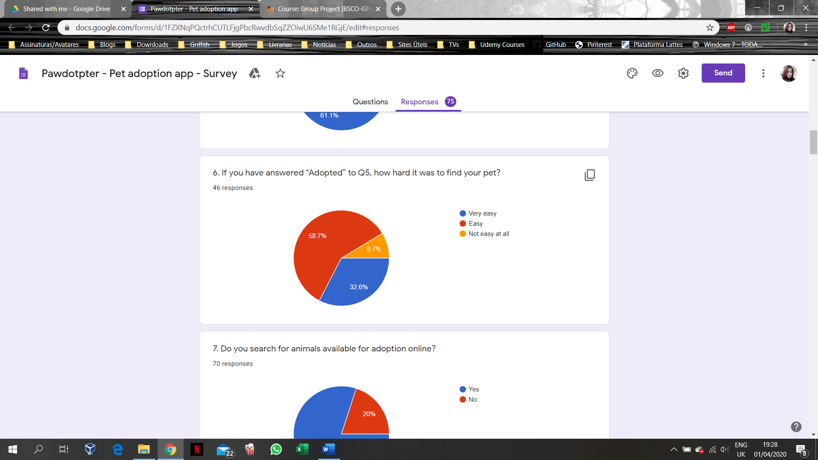
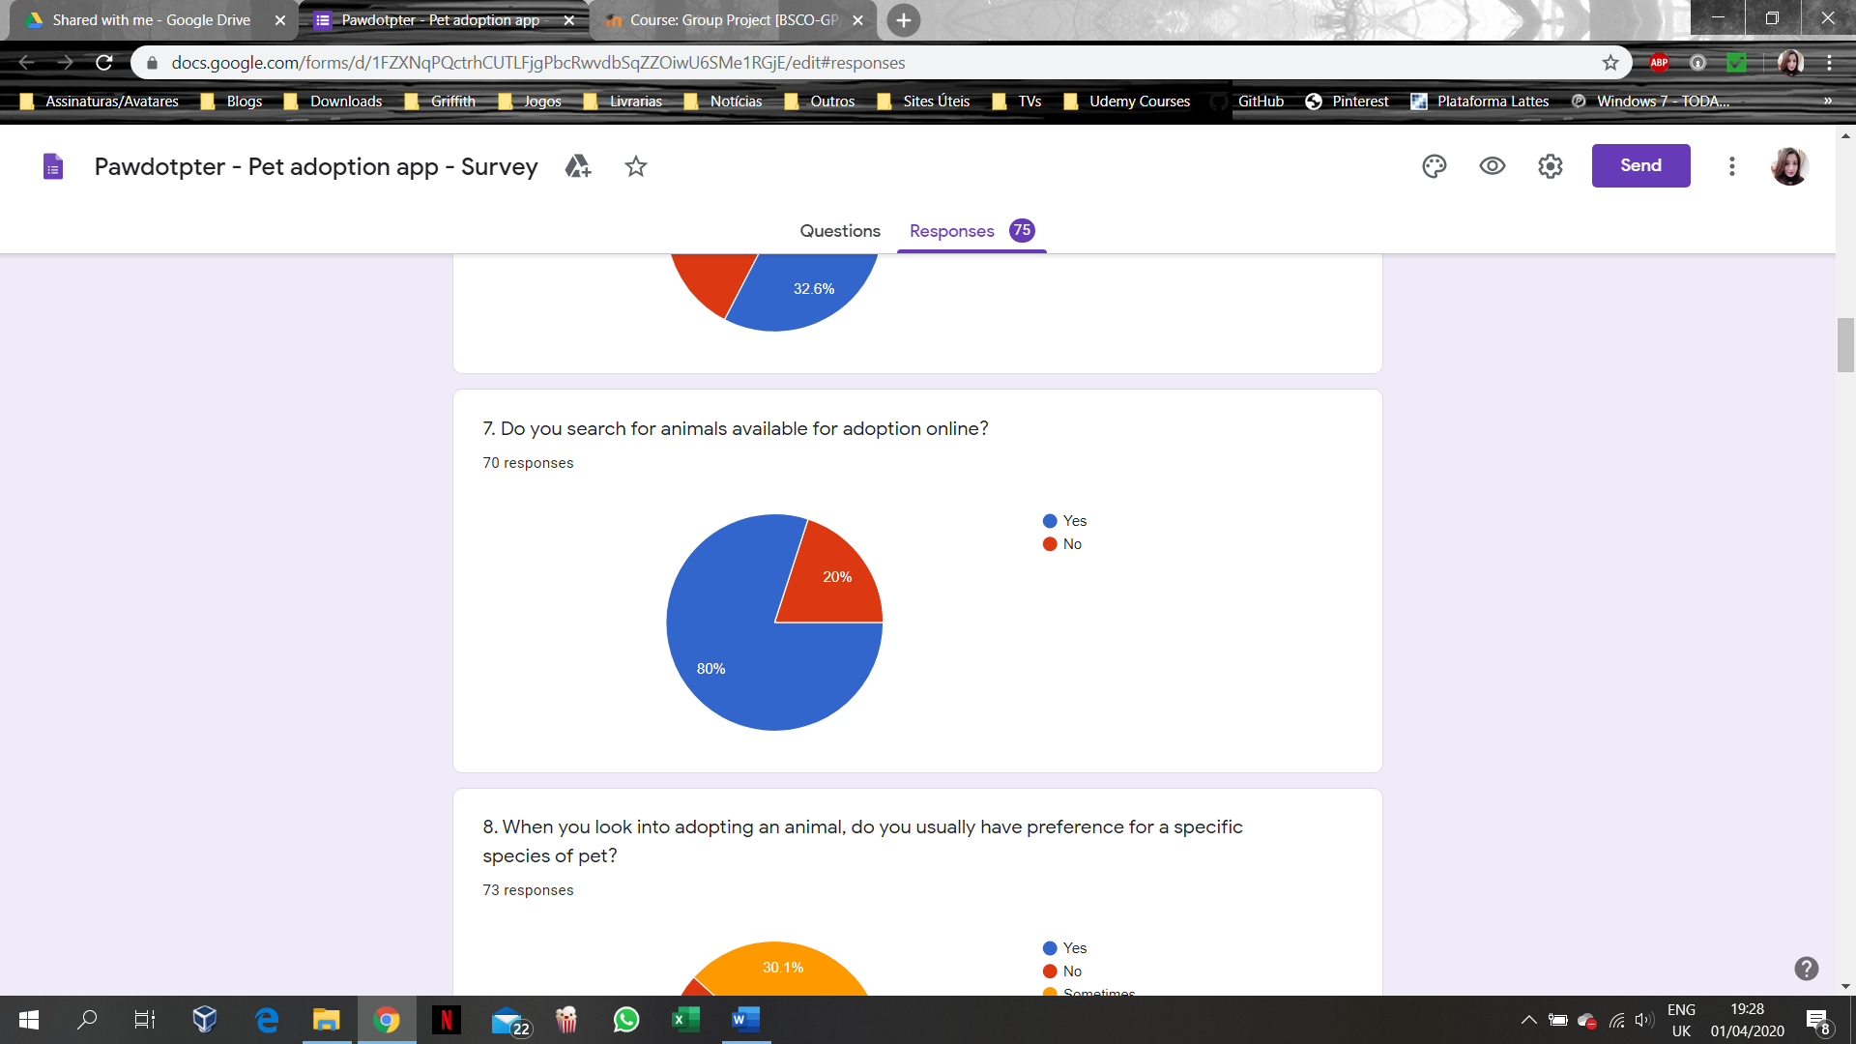
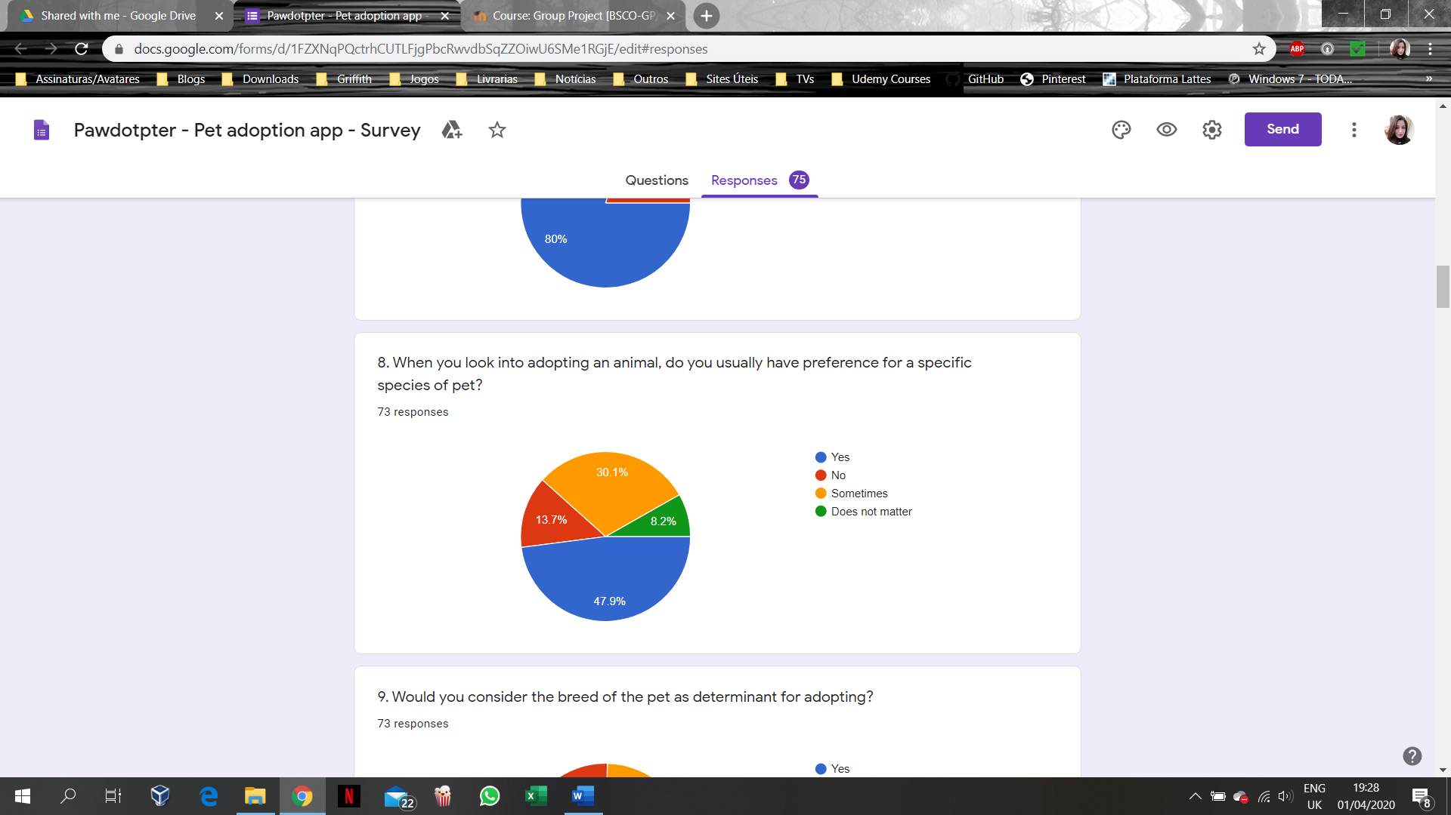
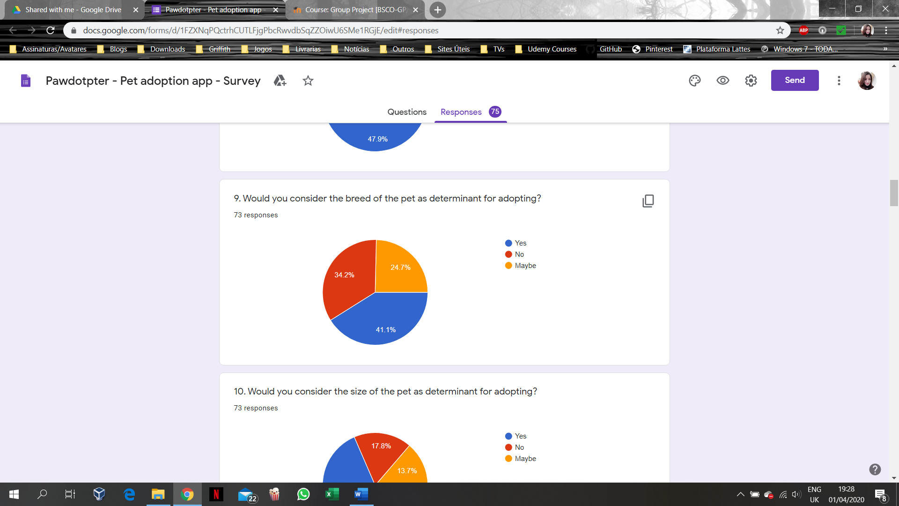
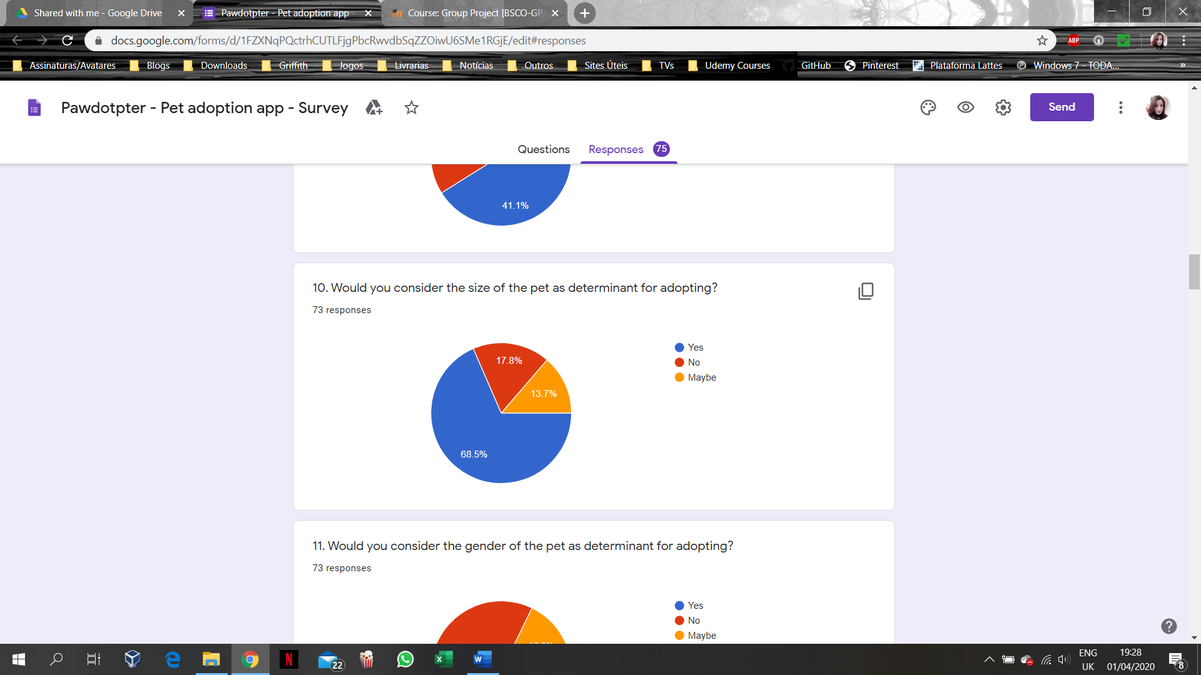
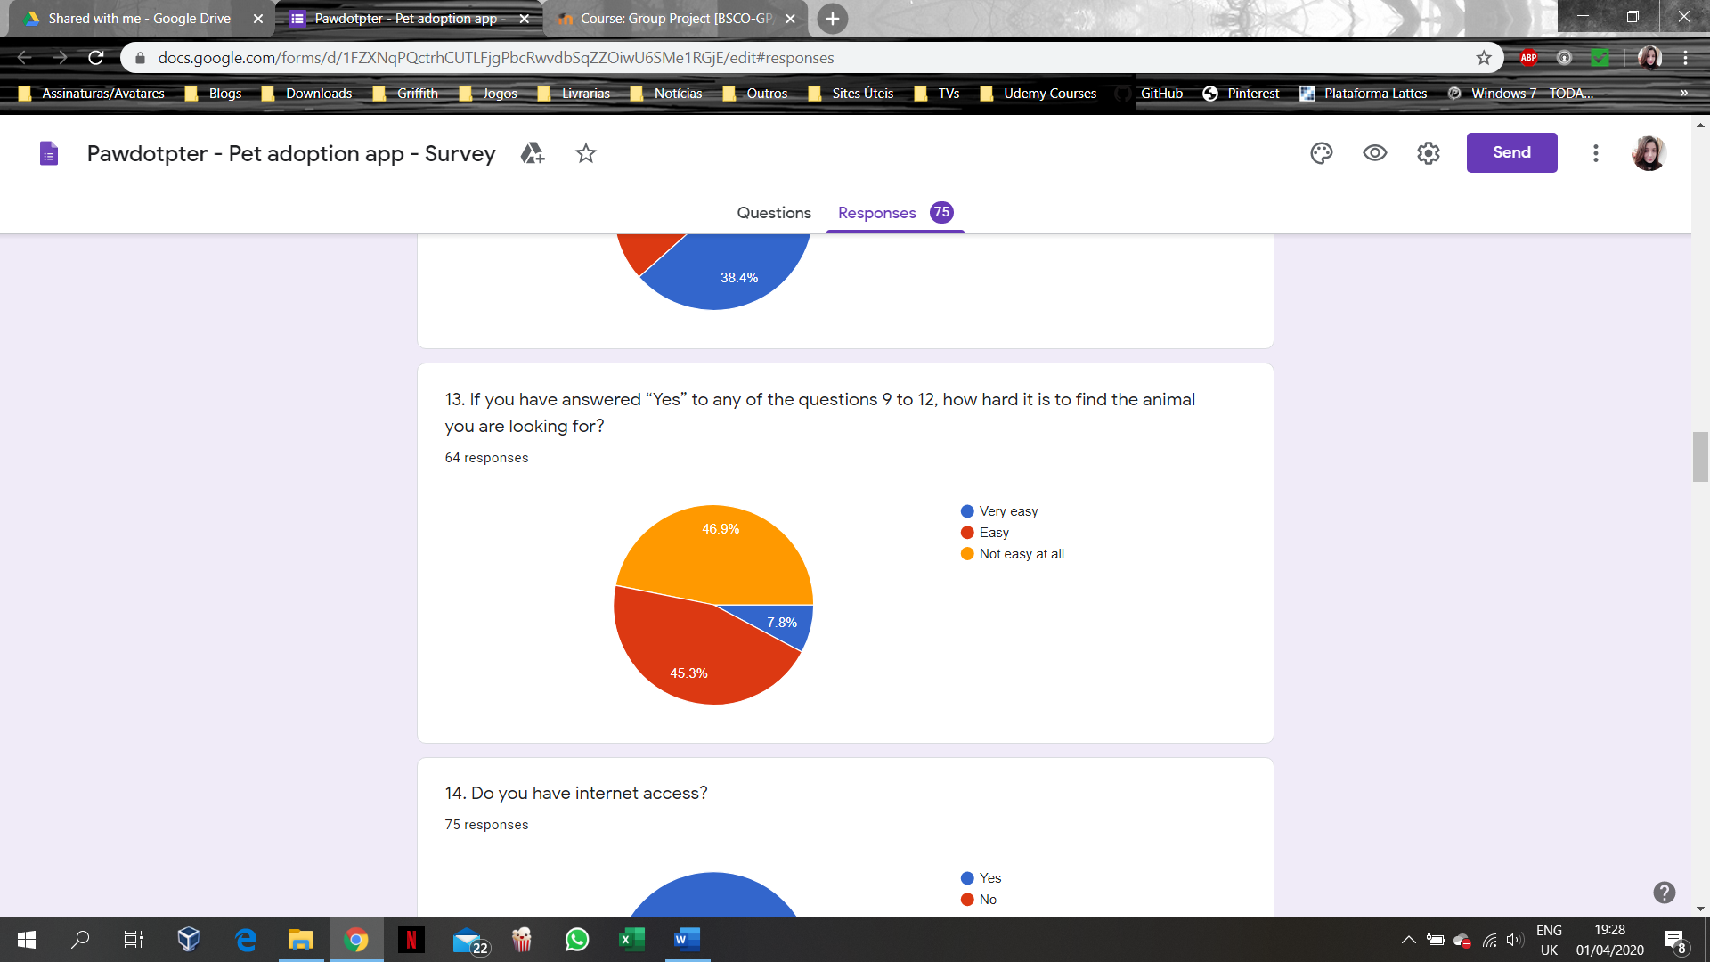
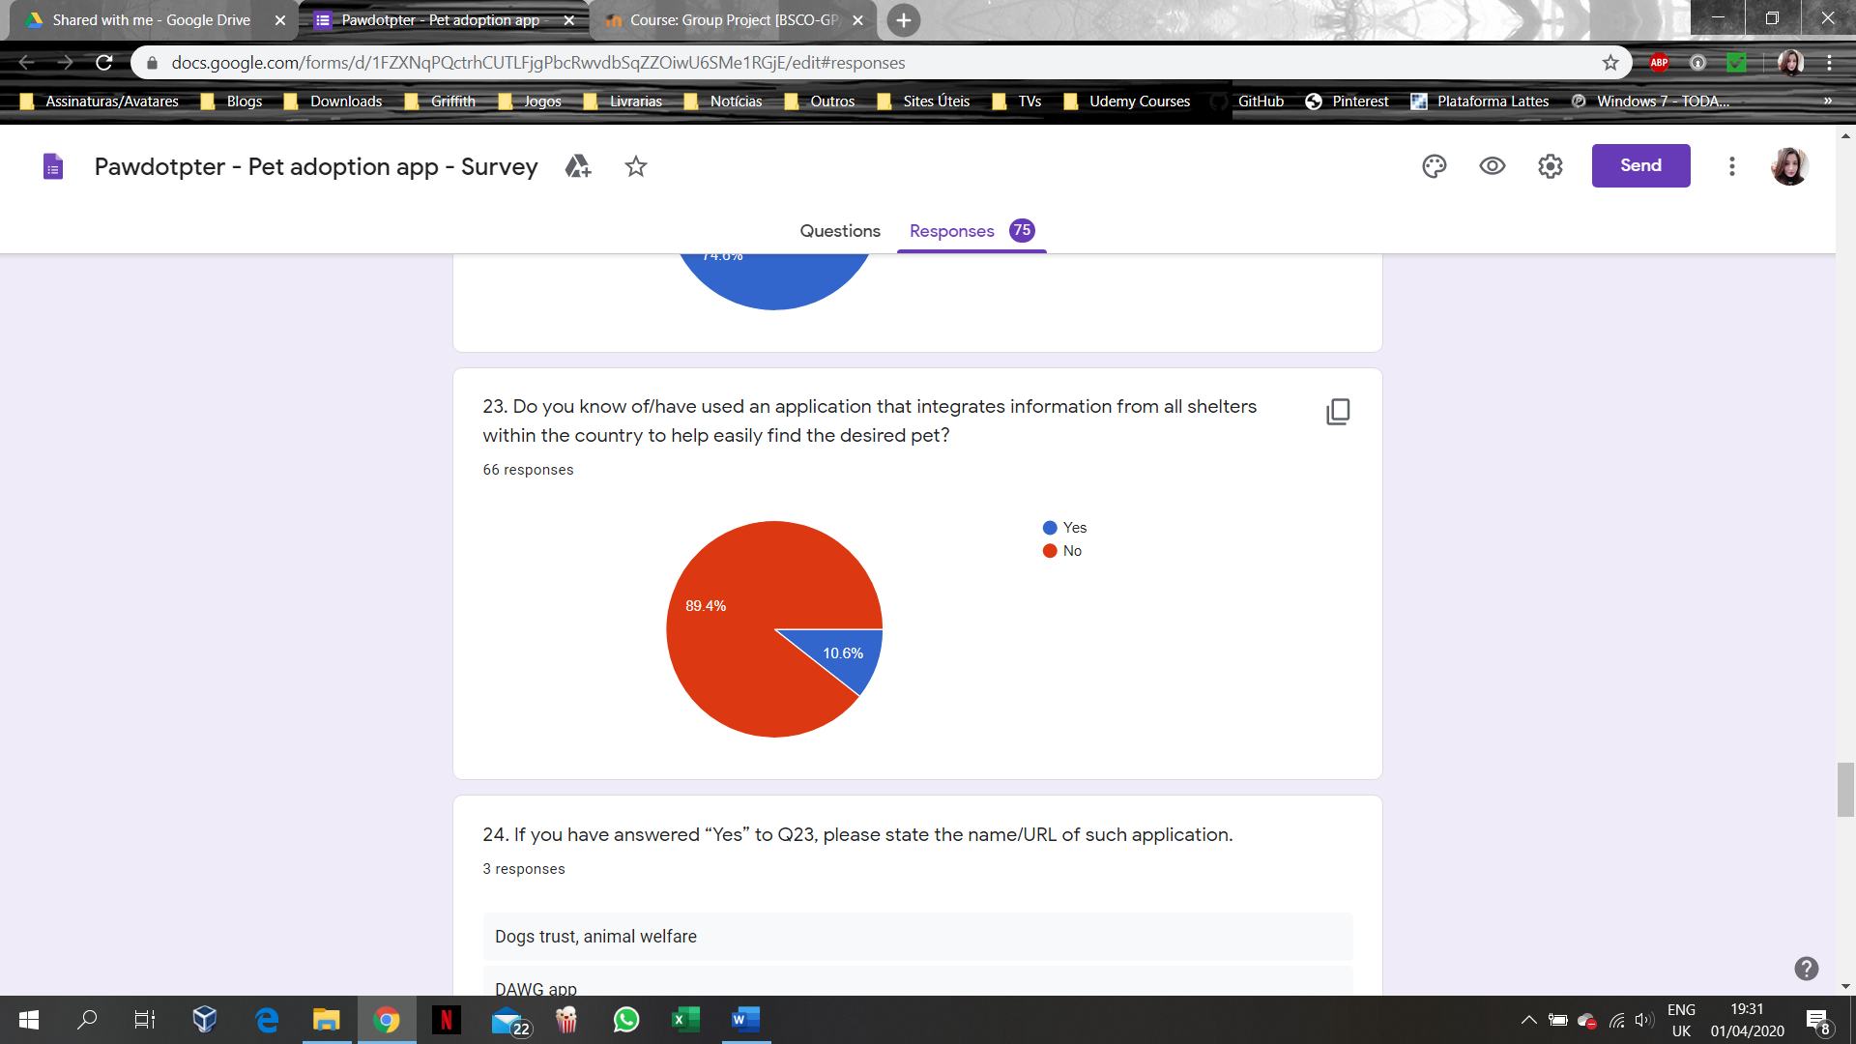
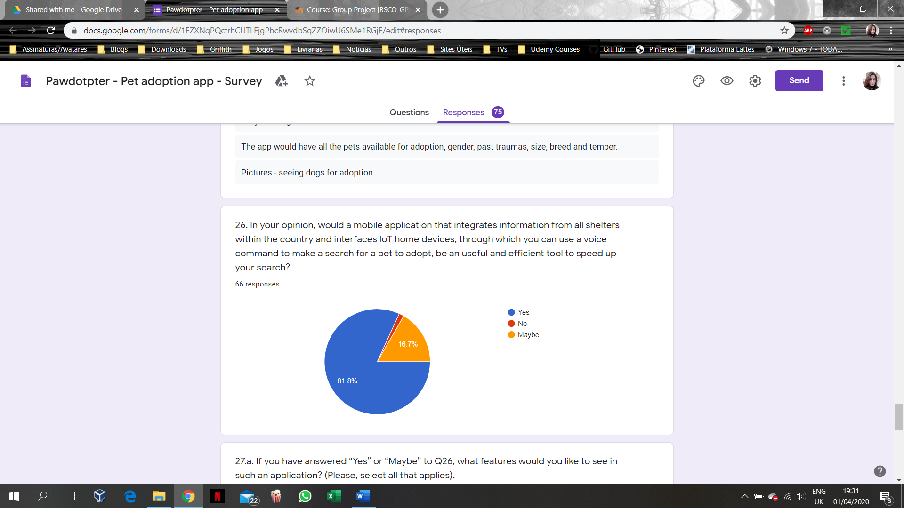
System Requirements (Initial Survey Results):
Google Forms Tool
Survey performed with 75 Participants in March’2020

Slide 10
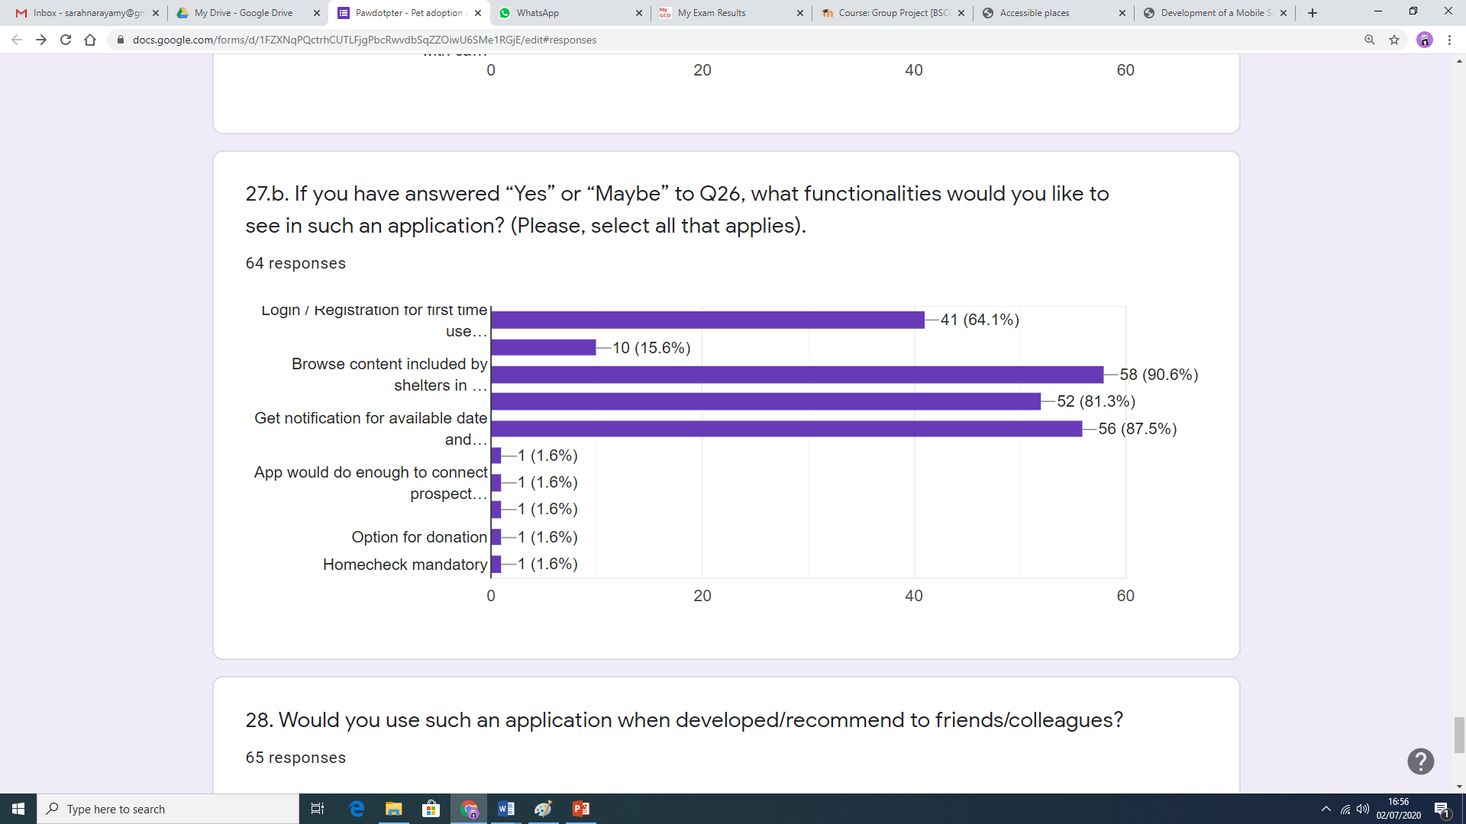
System Requirements (Initial Survey Results):
Login / Registration for first time users / Password reset;
Use IoT device;
Browse content;
Fill and send Adoption Intent form;
Get notification.

Slide 11
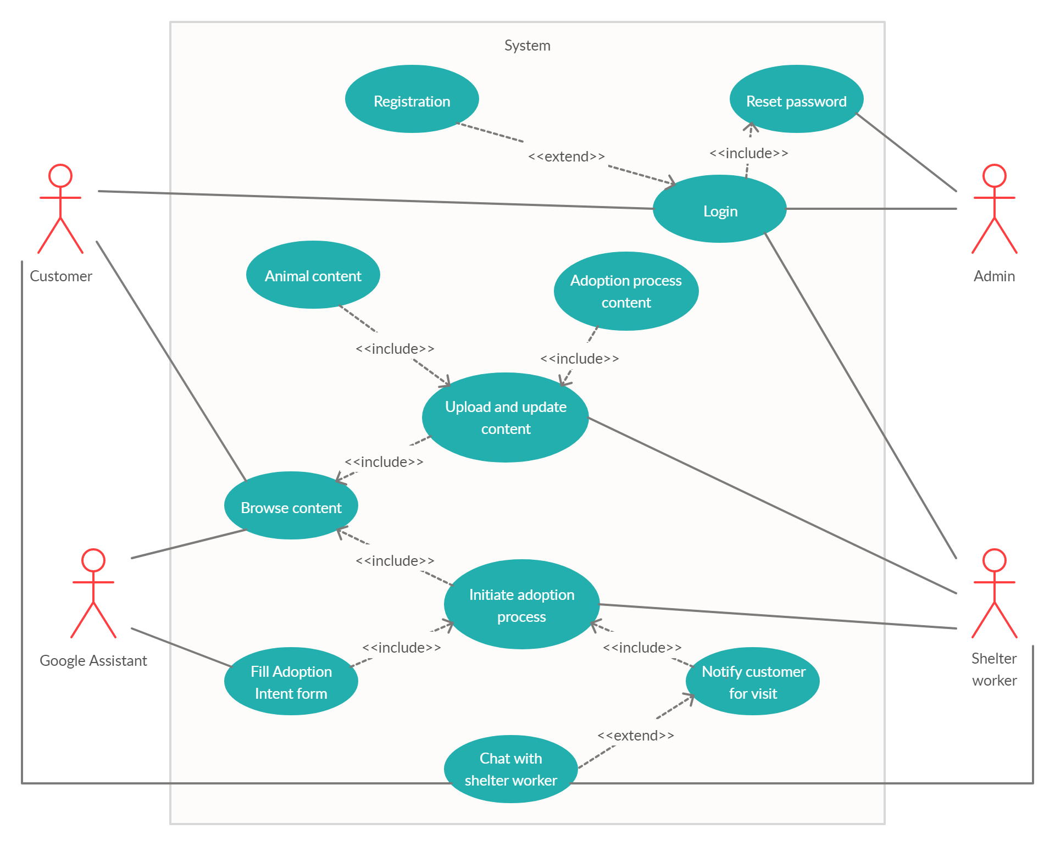
Use Case Diagram
Actors – involved in one or more functionalities;
Use Case – functional requirement of the system;
<<include>> and <<extend>> relationships.

Slide 12
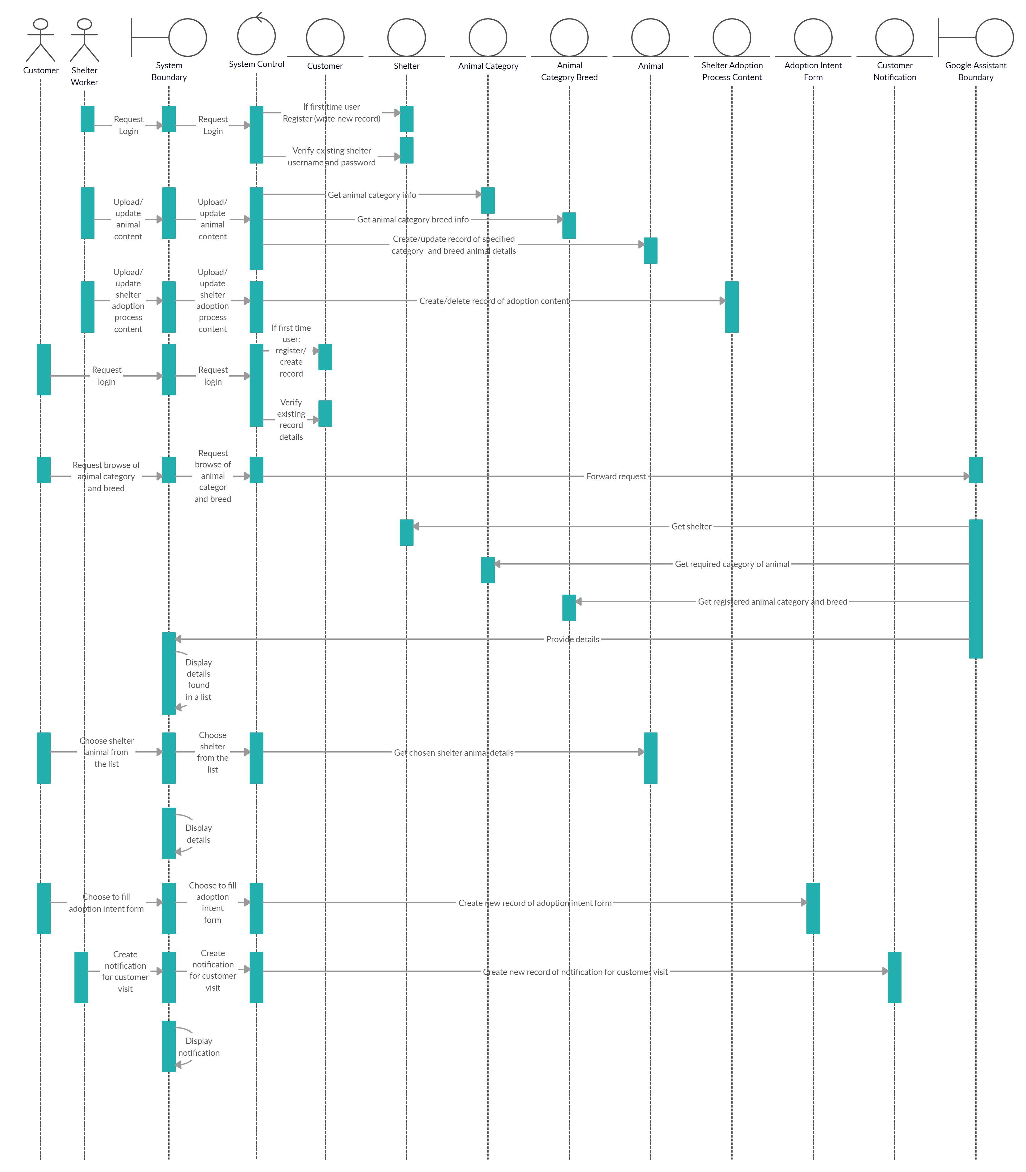
Interactions between objects within the system;
Actor – plays a role in the system;
Boundary;
System Control;
Persistent Entities.

Slide 14
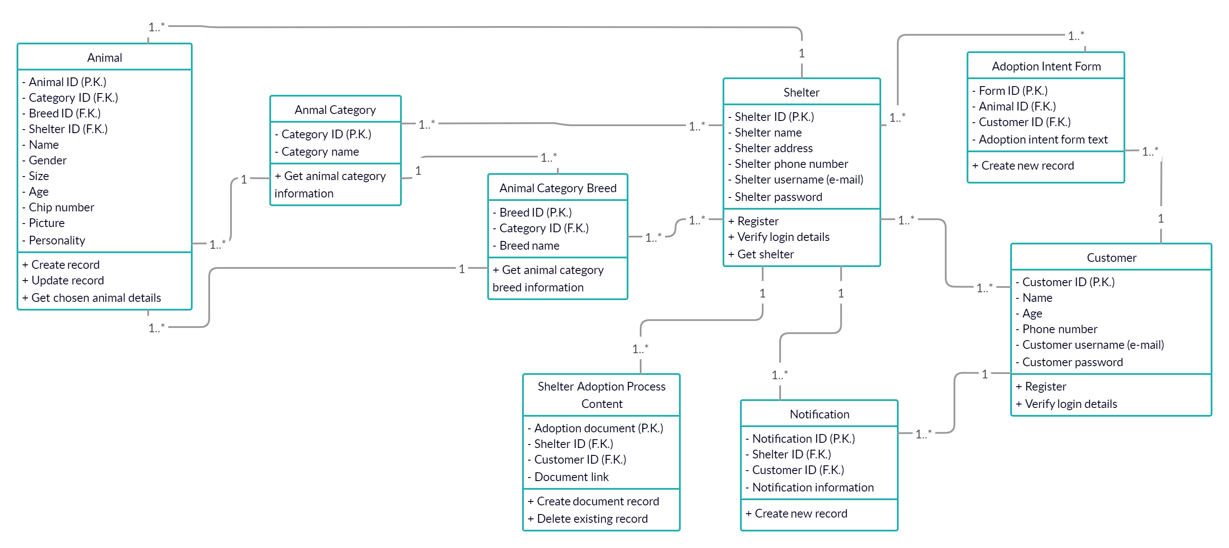
Object Class Diagram

Slide 15
Alternative Solutions
Low-End Solution | Mid-Range Solution | High-End Solution
Login/ Registration Reset Password Browse Content | Login/ Registration Reset Password Browse Content Fill Adoption Intent form Initiate adoption process Notify user for visit Connect the app with Google Home Assistant for voice command search | Login/ Registration Reset Password Browse Content Perform Voice Command search through Google Home Assistant Fill Adoption Intent form Initiate adoption process Notify user for visit Live chat with shelter worker

Slide 16
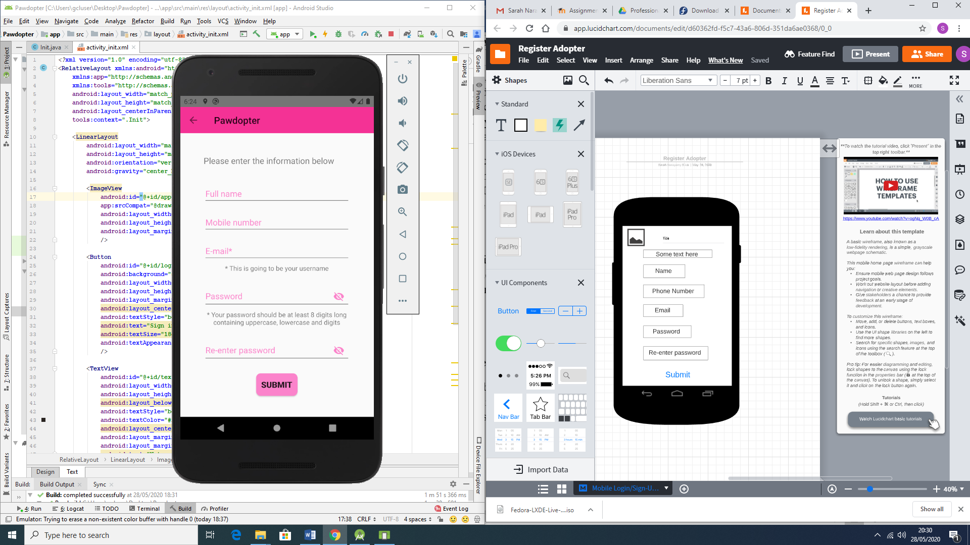
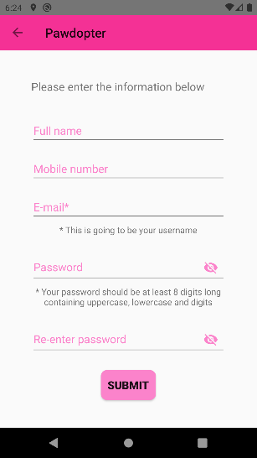
Screen Designs
Registration screen wireframe (left);
Actual registration screen (right);
Logic and flow of the application operation.

Slide 17
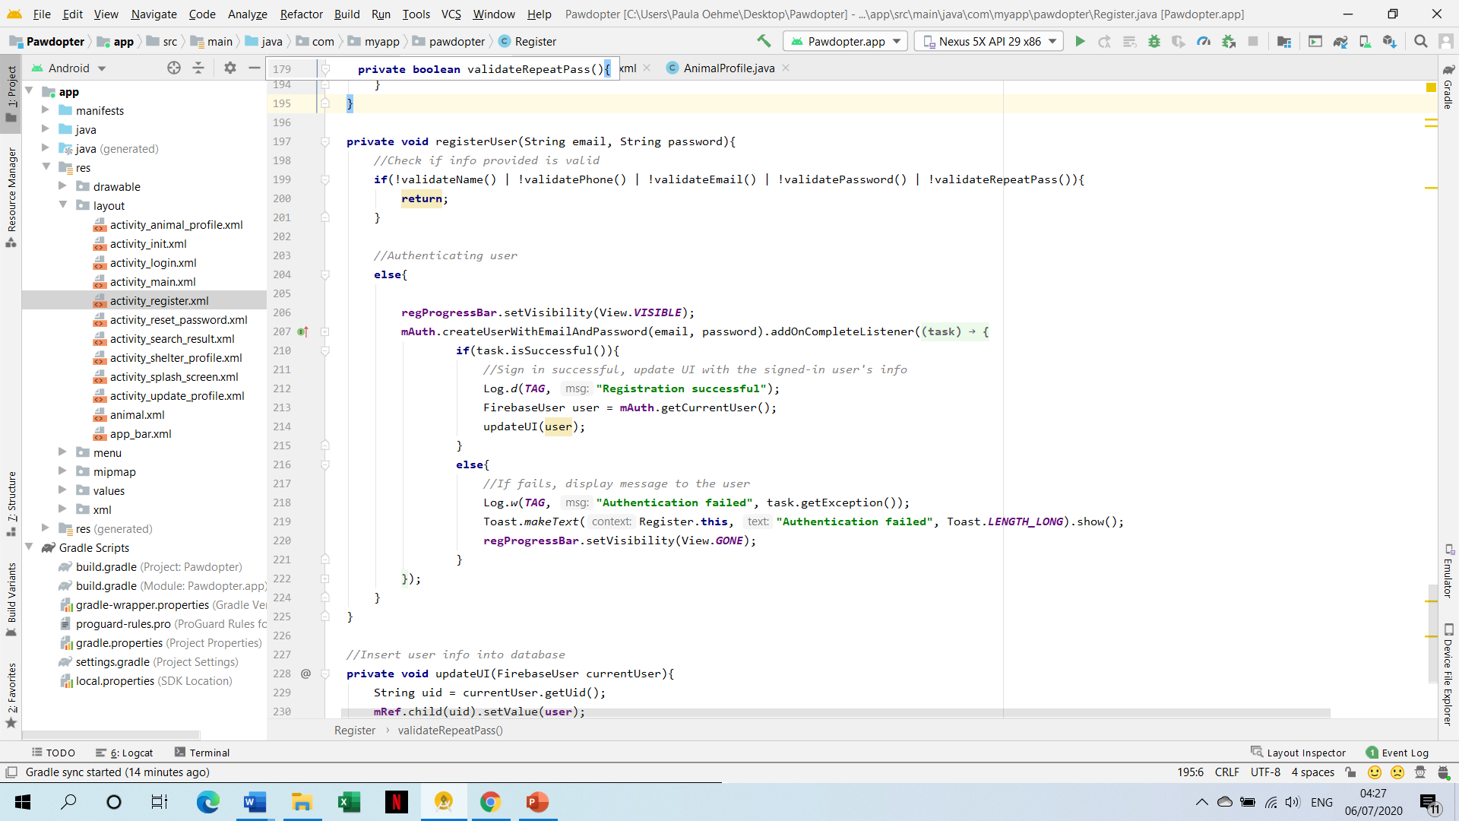
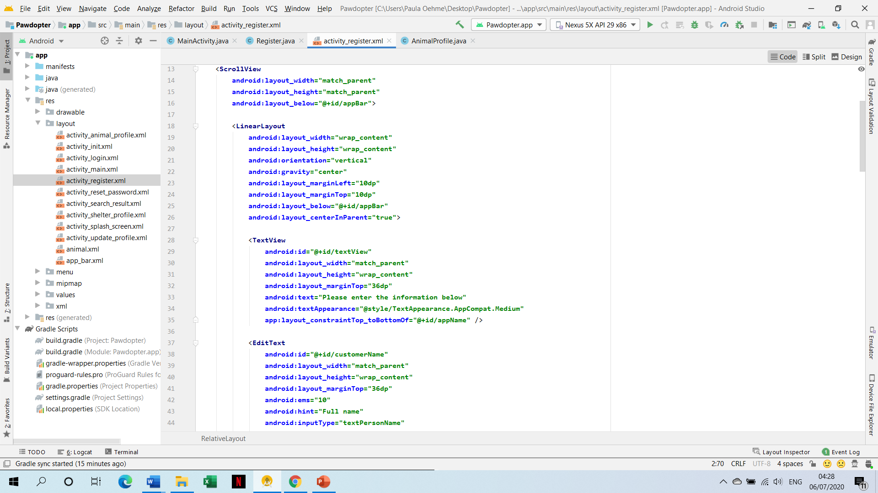
Screen Designs cont.
Snippets of Code for the Registration Screen

Slide 18
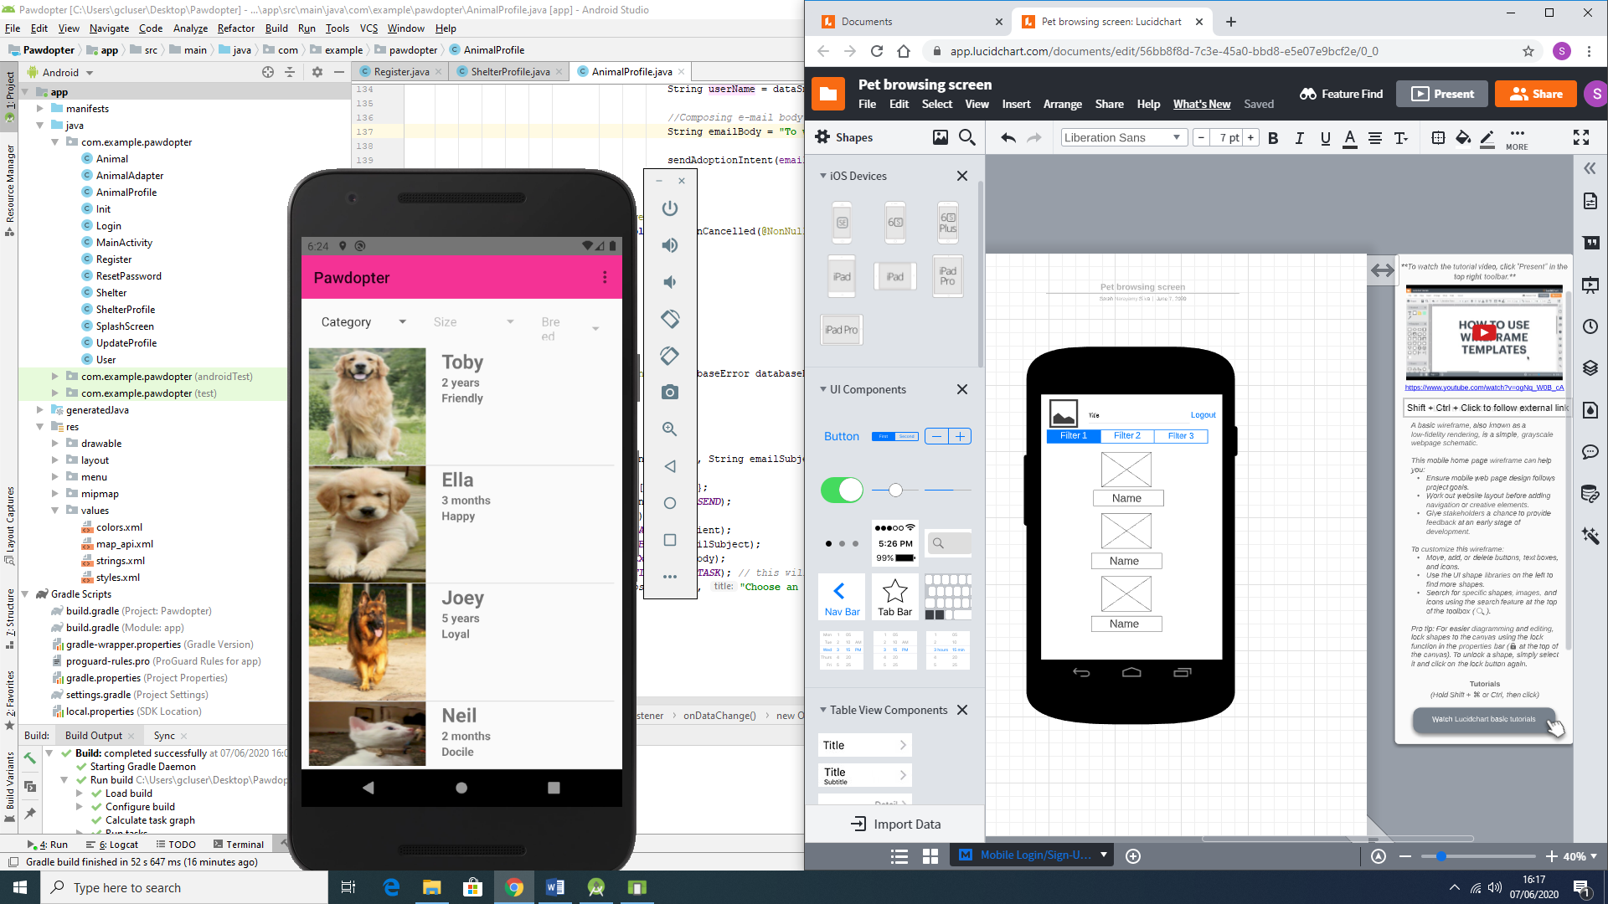
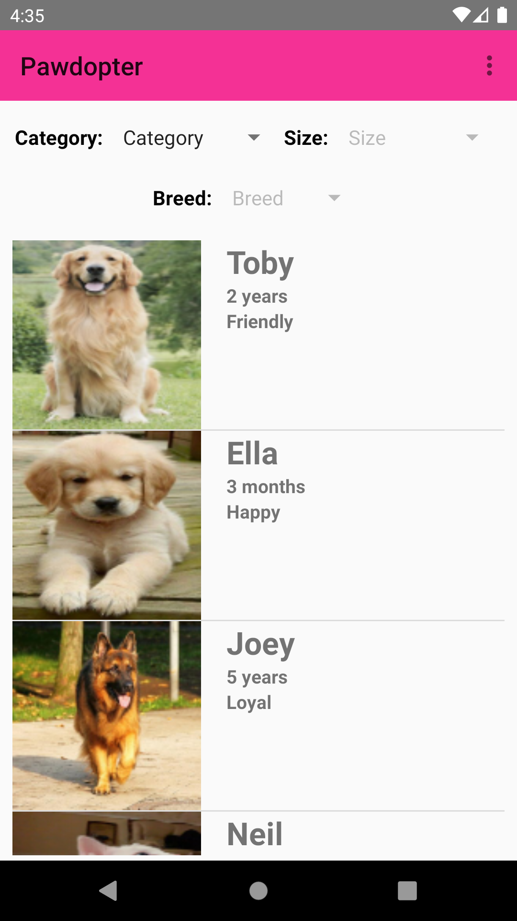
Screen Designs cont.
Pet browsing and filtering screen wireframe (left);
Actual pet browsing and filtering screen (right);

Slide 19
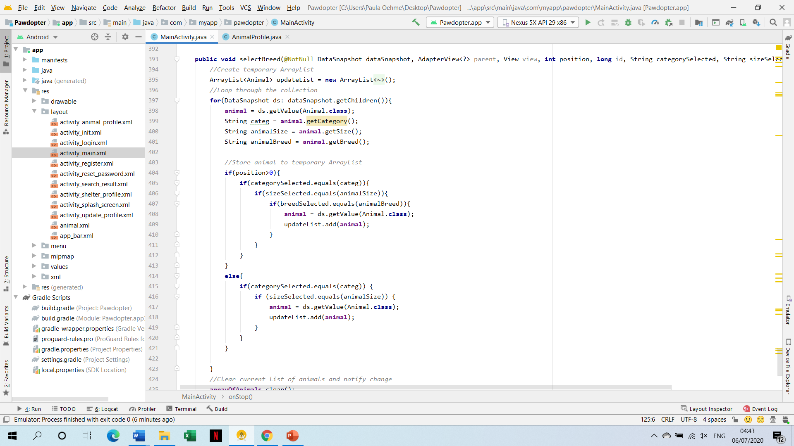
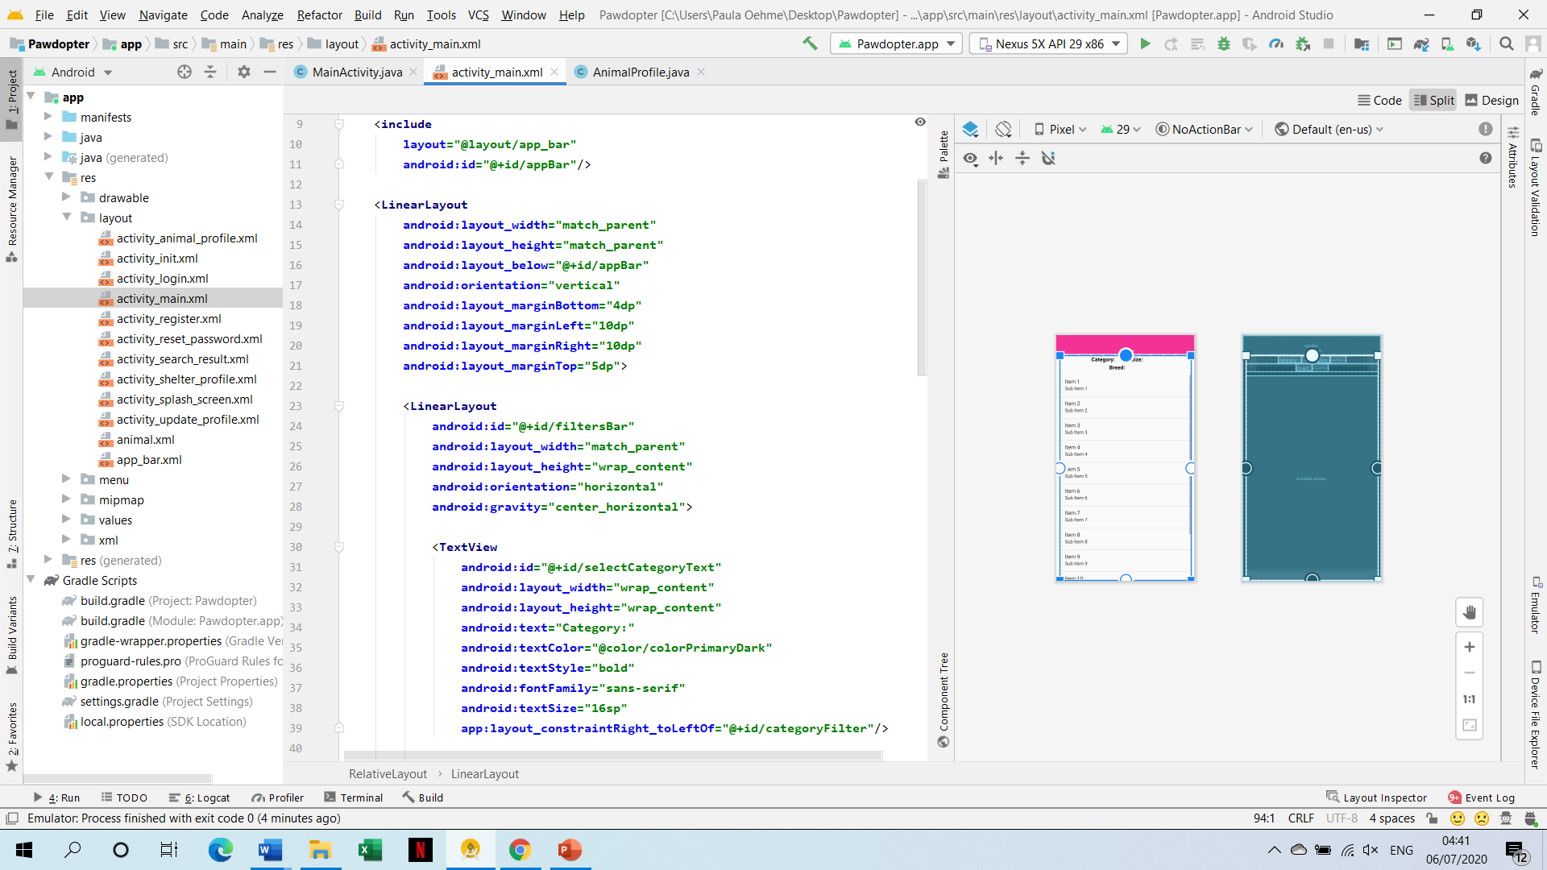
Screen Designs cont.
Snippets of Code for the Pet Browsing & Filtering Screen

Slide 20
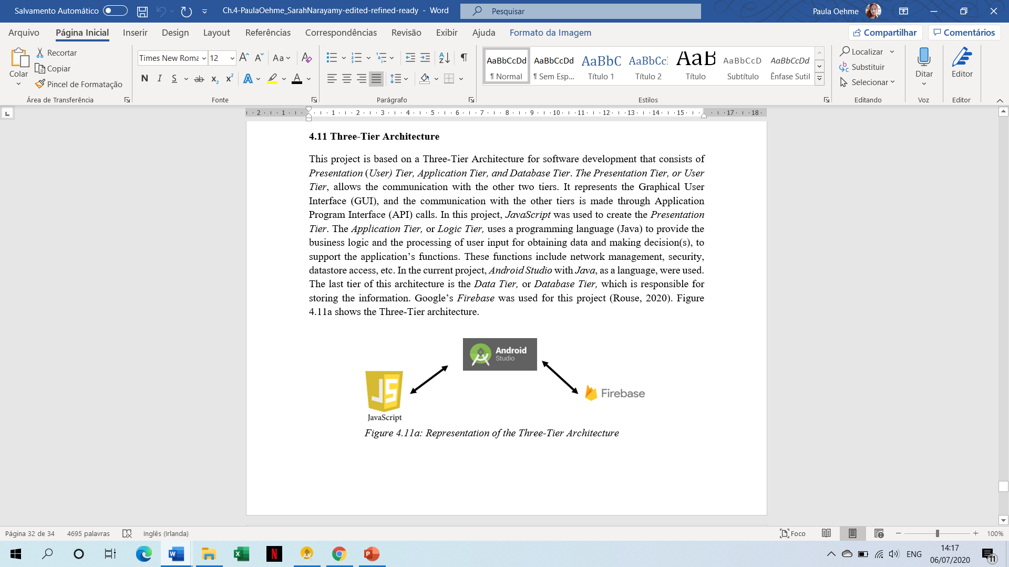
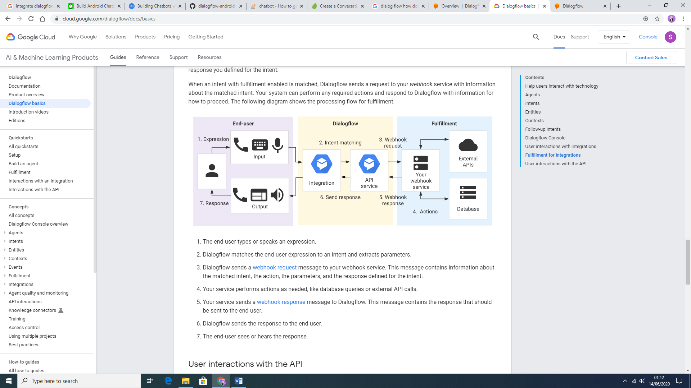
Three-Tier Architecture
Presentation Tier:
Graphical User Interface
API
Application Tier:
Logic
Processing user input
Database Tier:
Storing information.

Slide 21
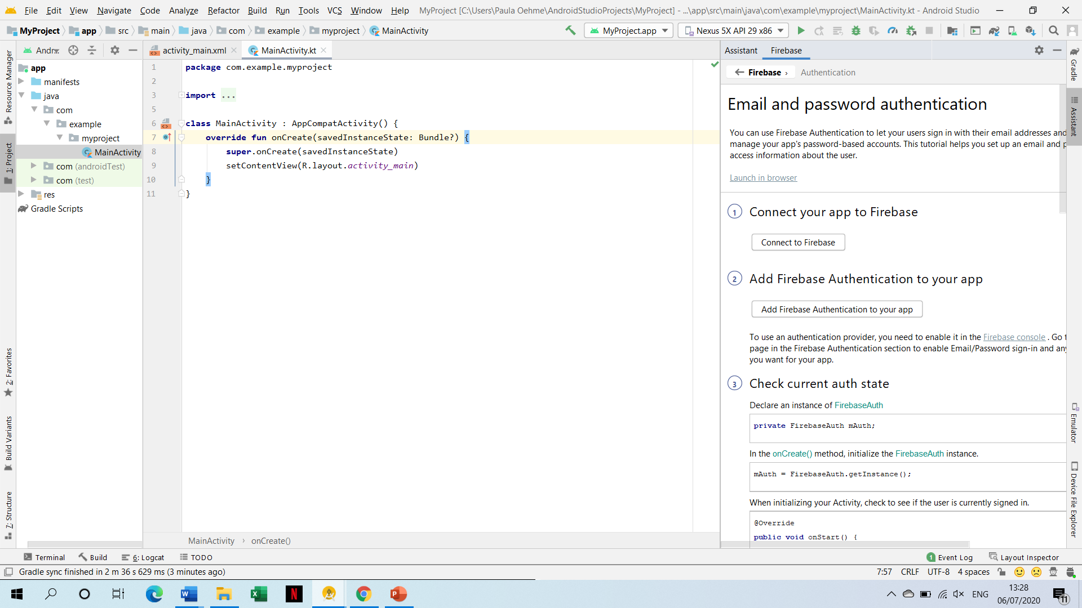
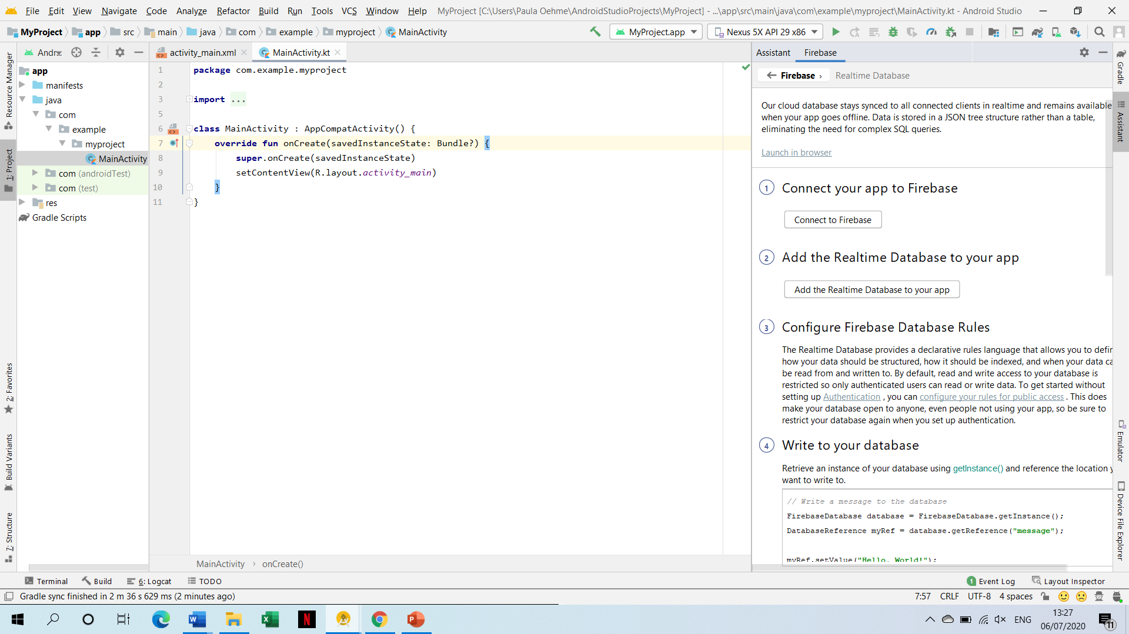
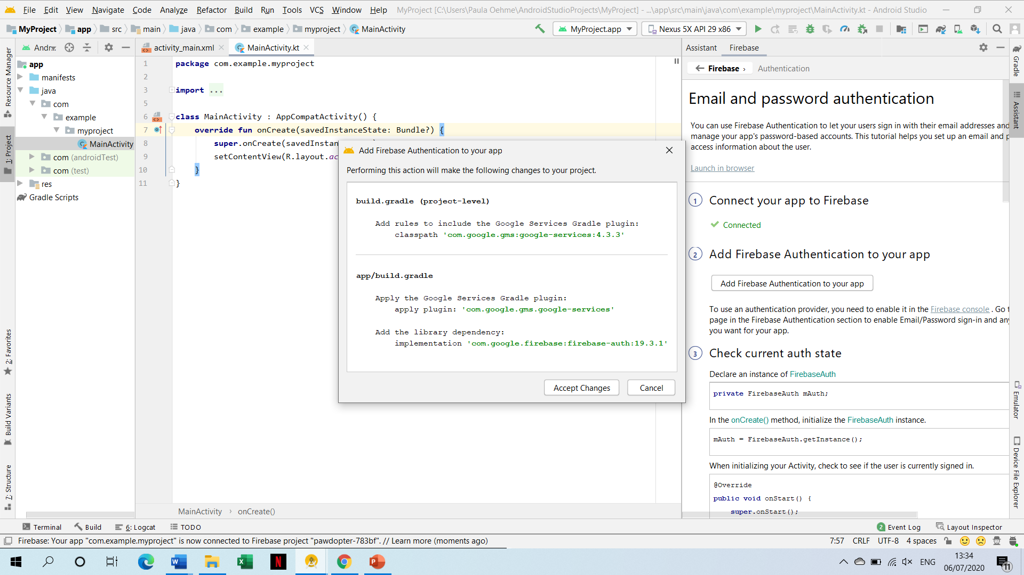
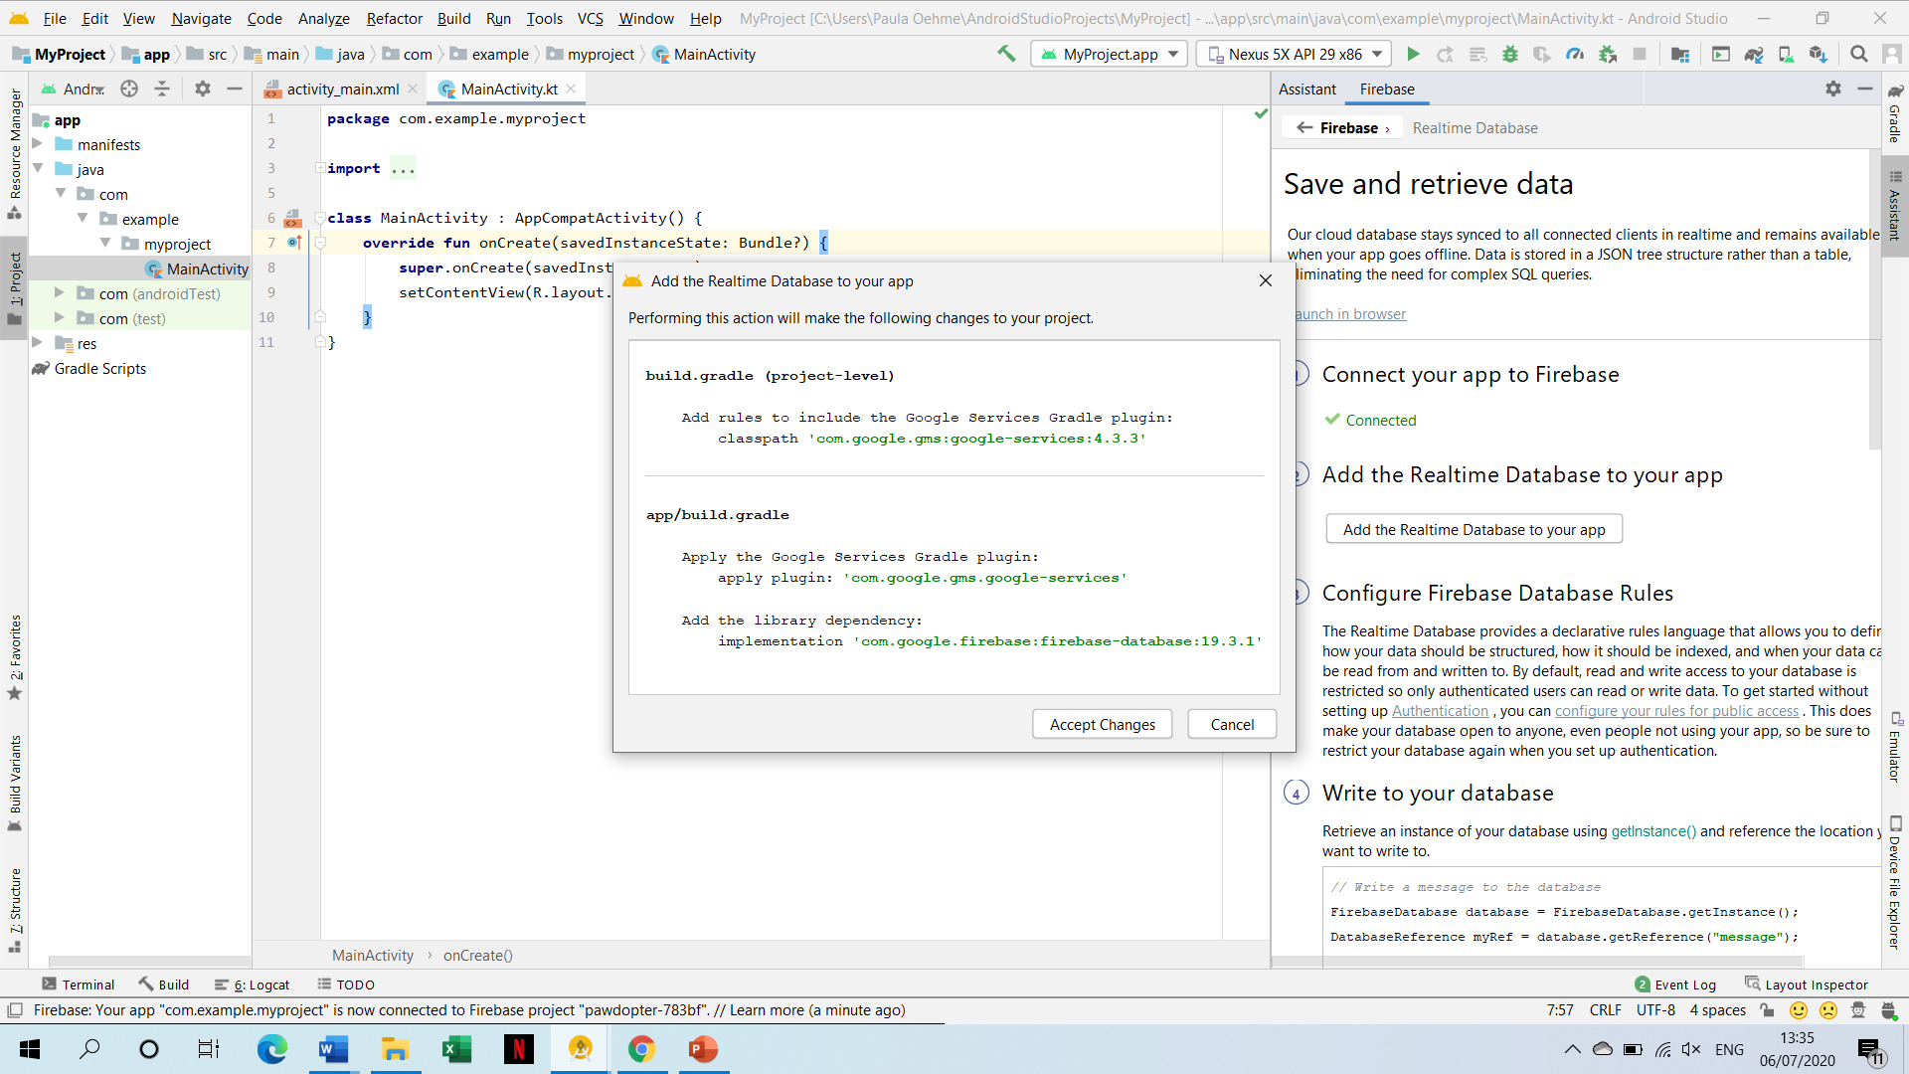
Database Connectivity (Firebase Database with Android Studio)

Slide 22
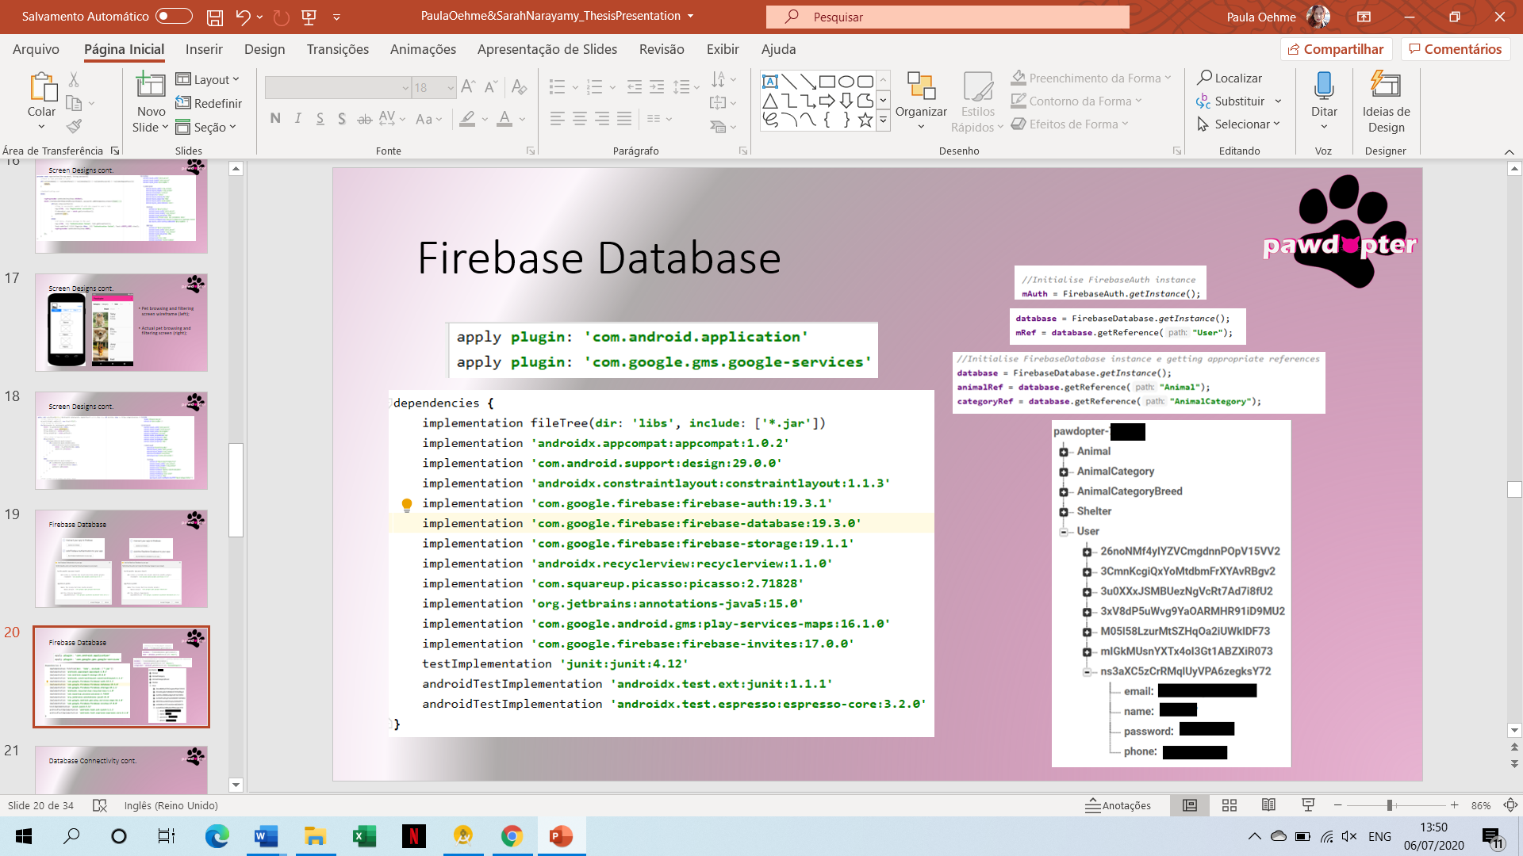
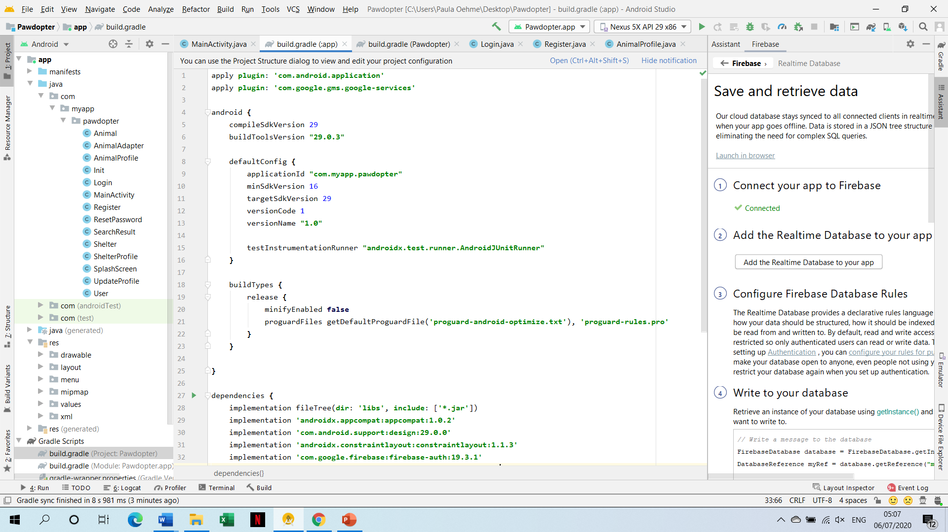
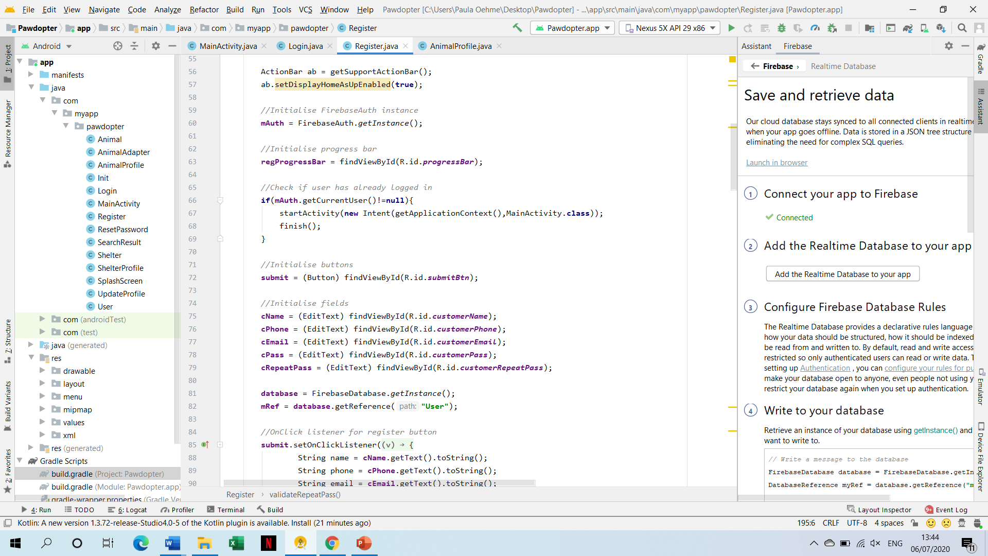
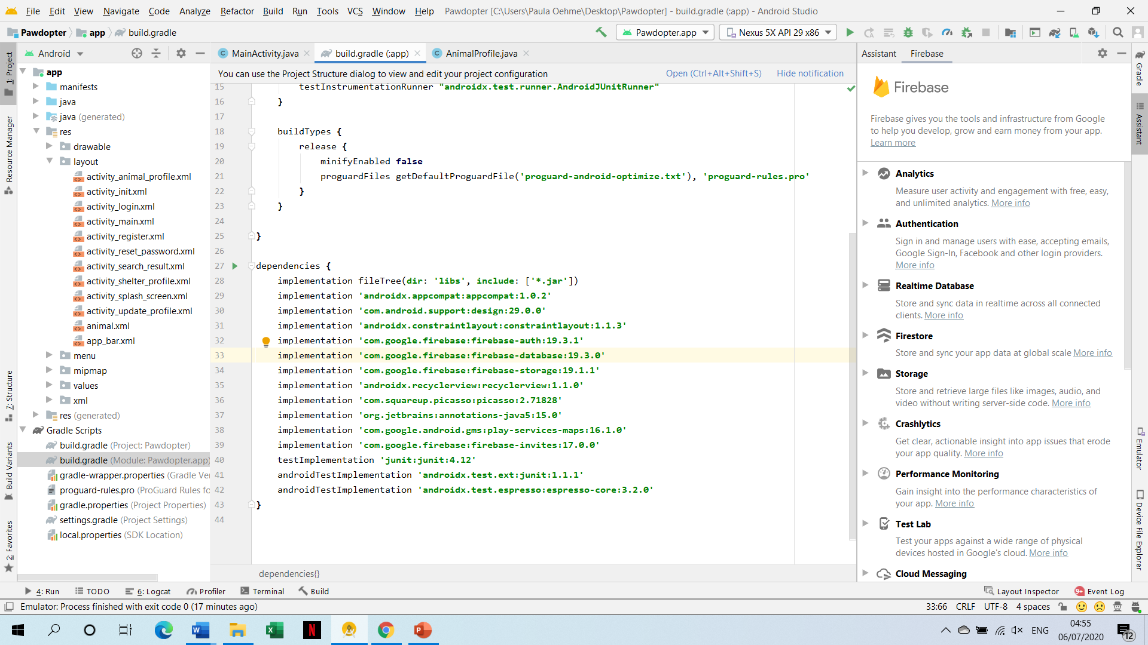
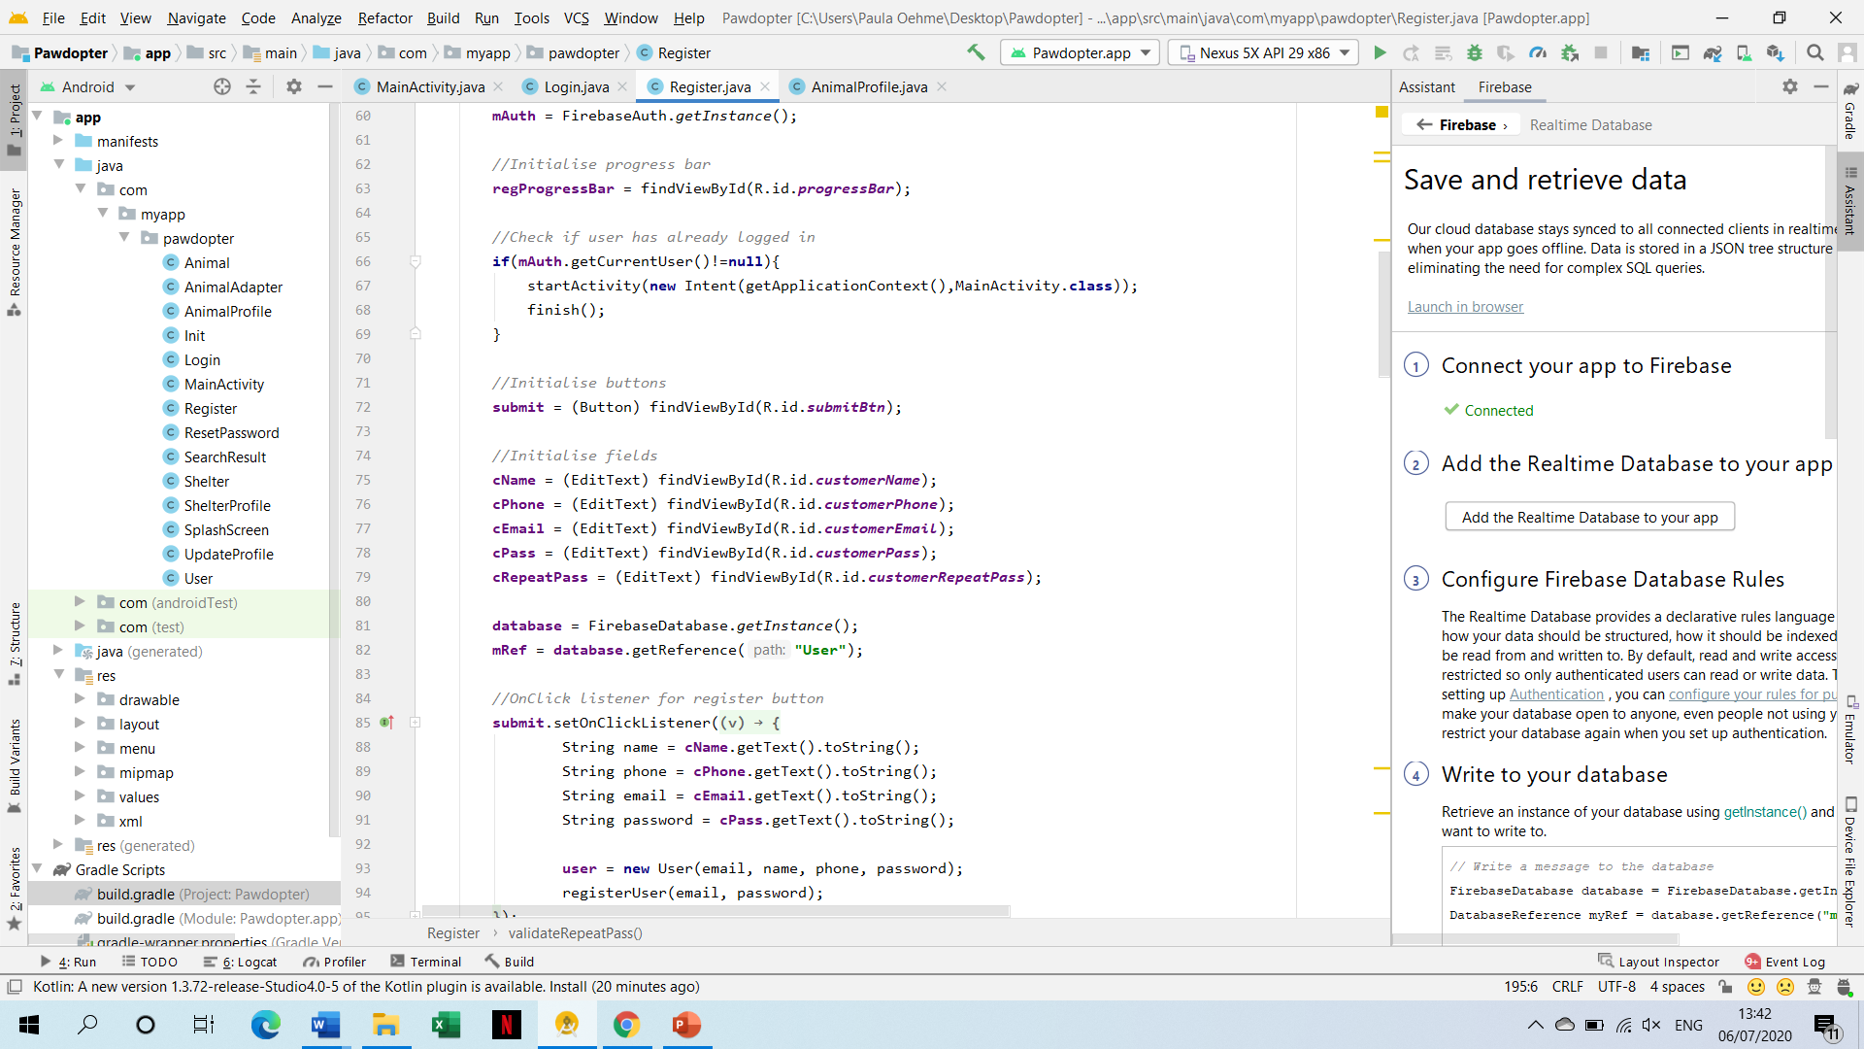
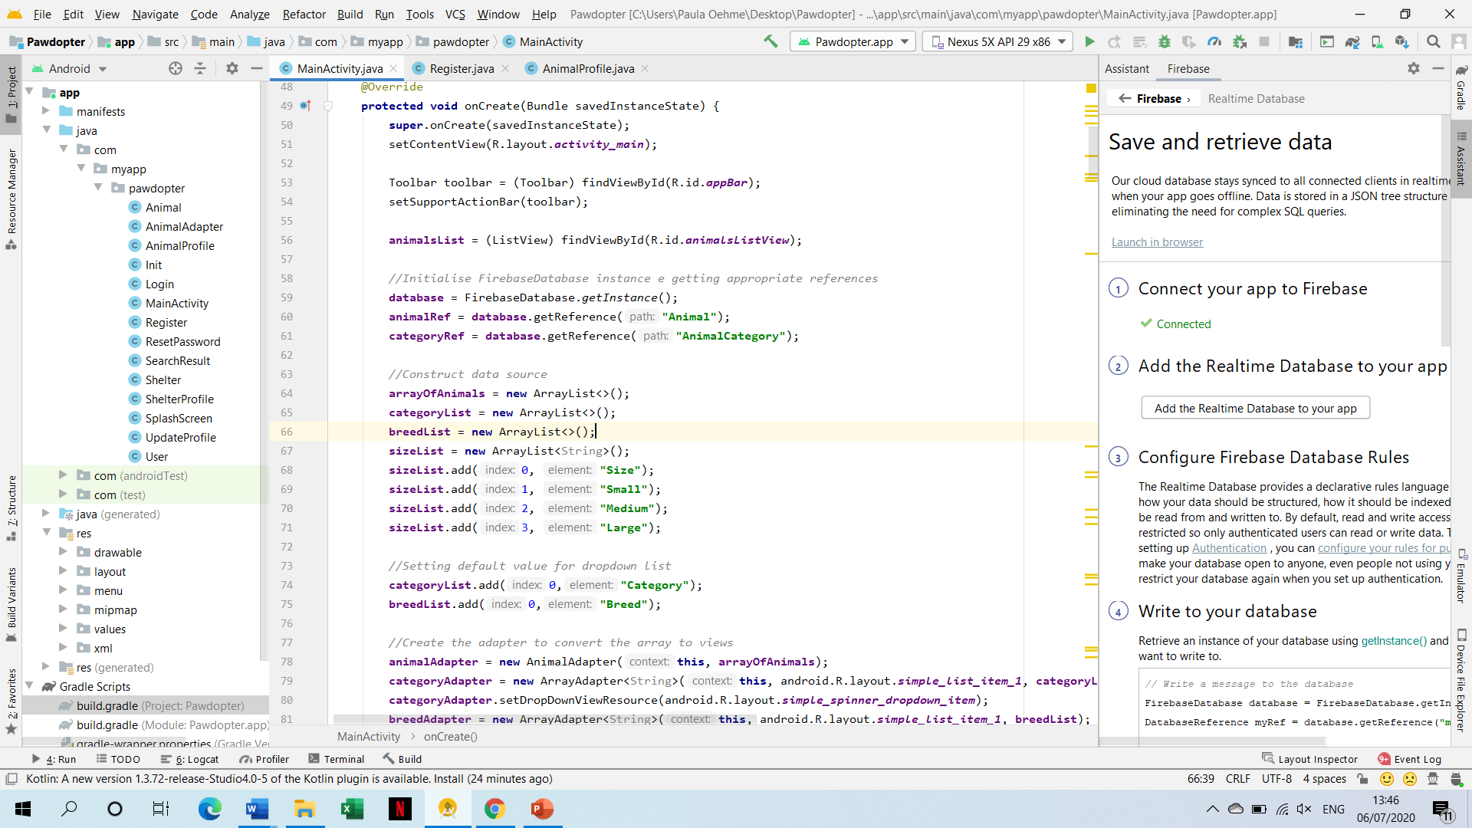
Database Connectivity (Firebase Database with Android Studio)

Slide 23
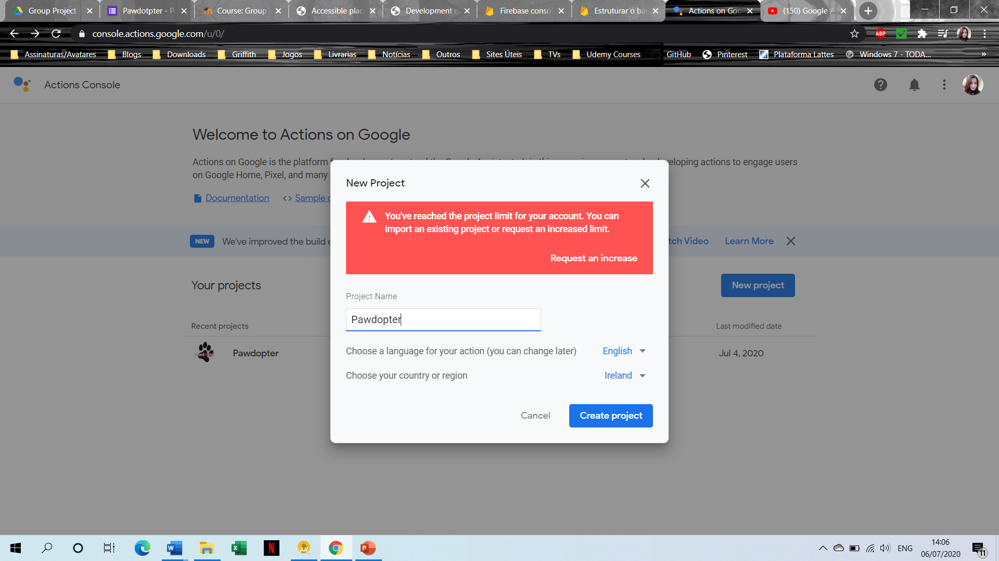
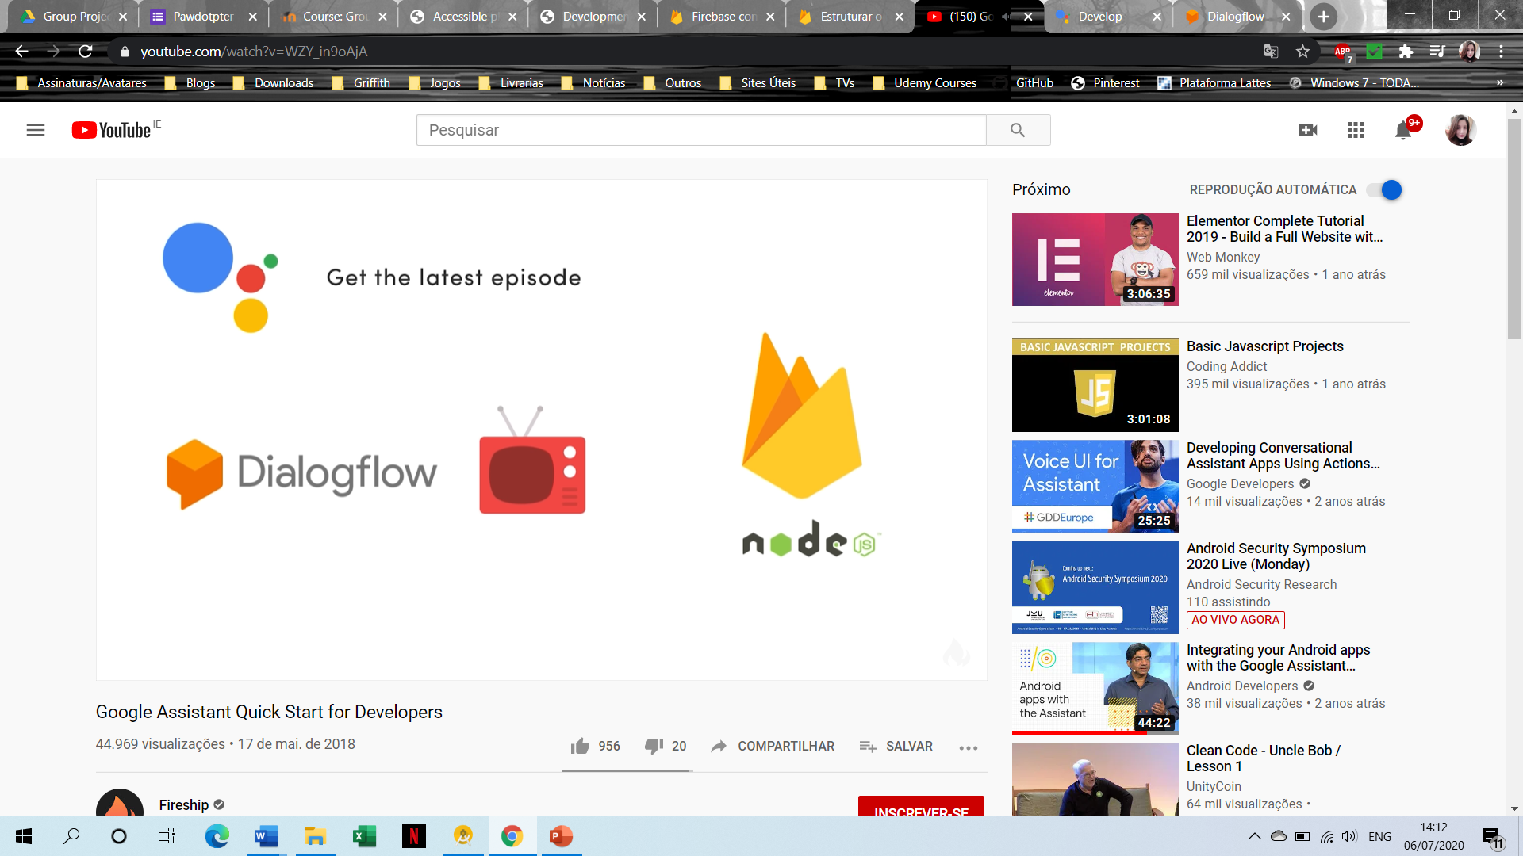
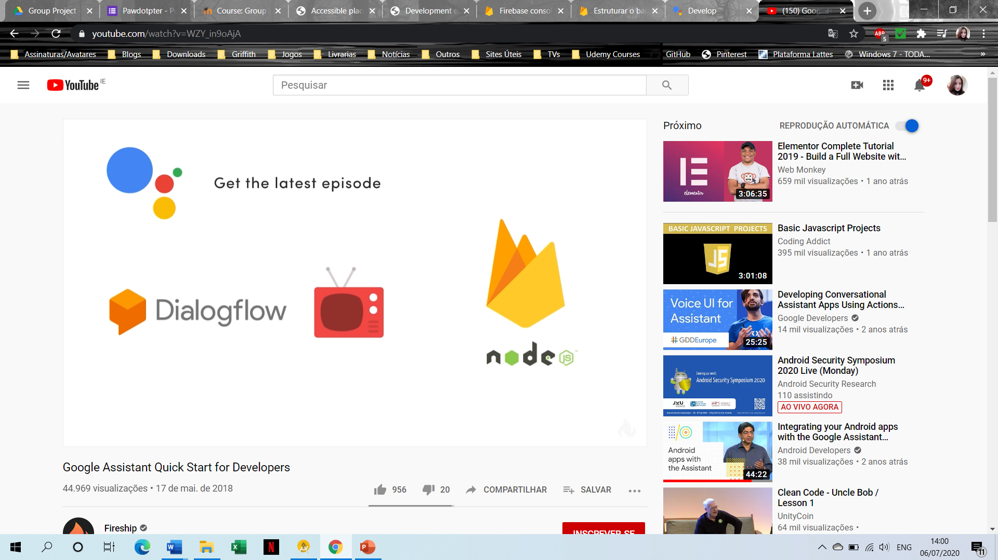
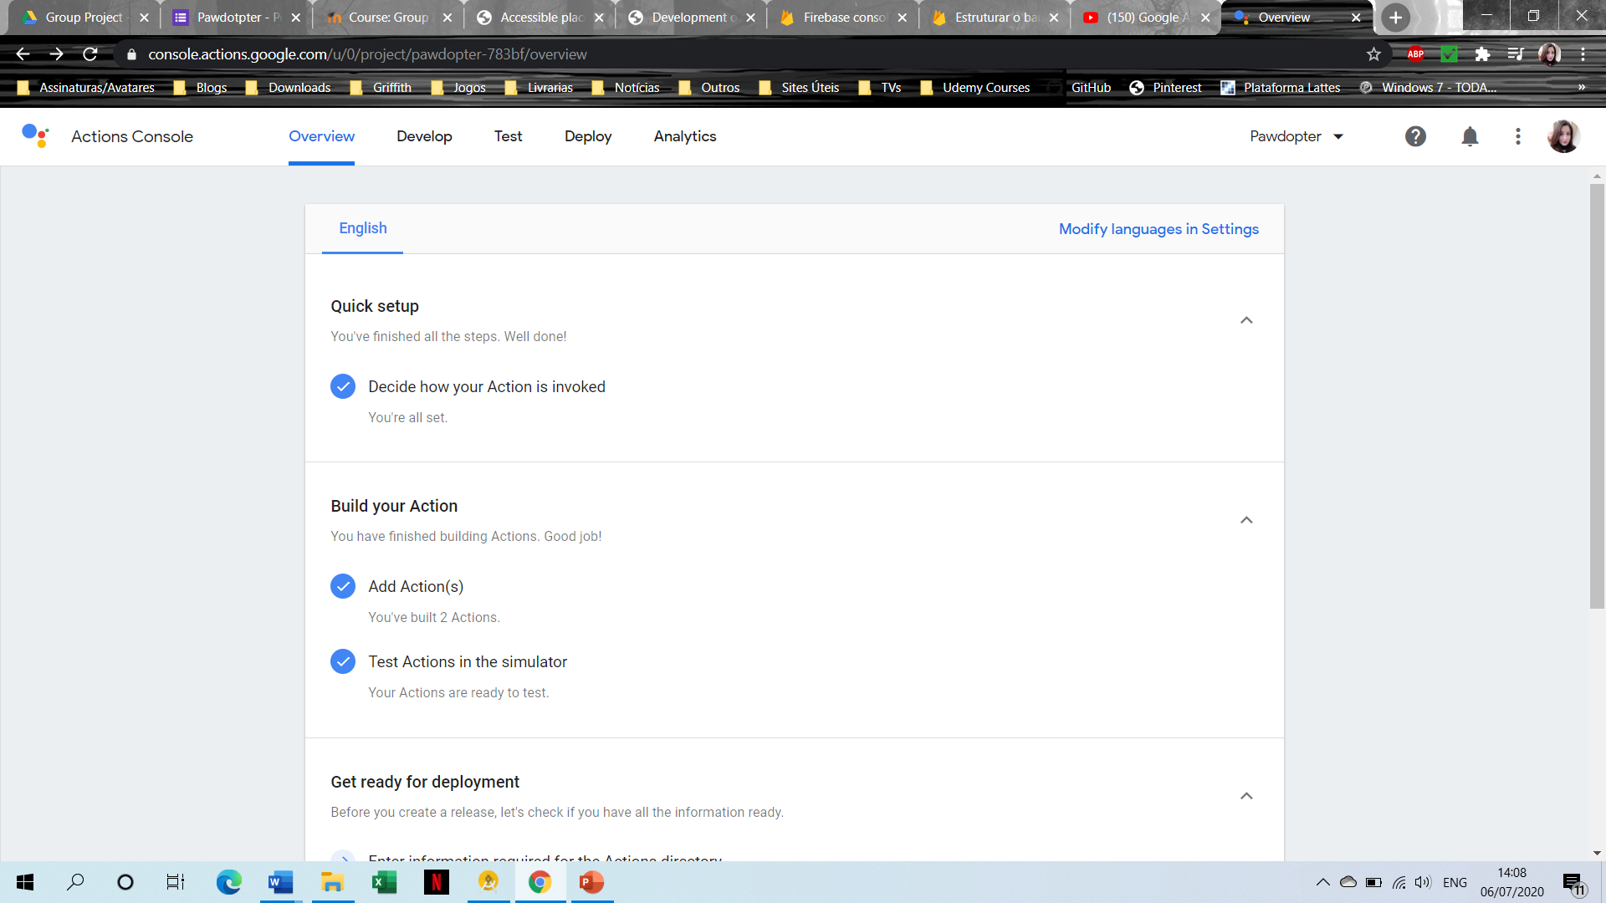
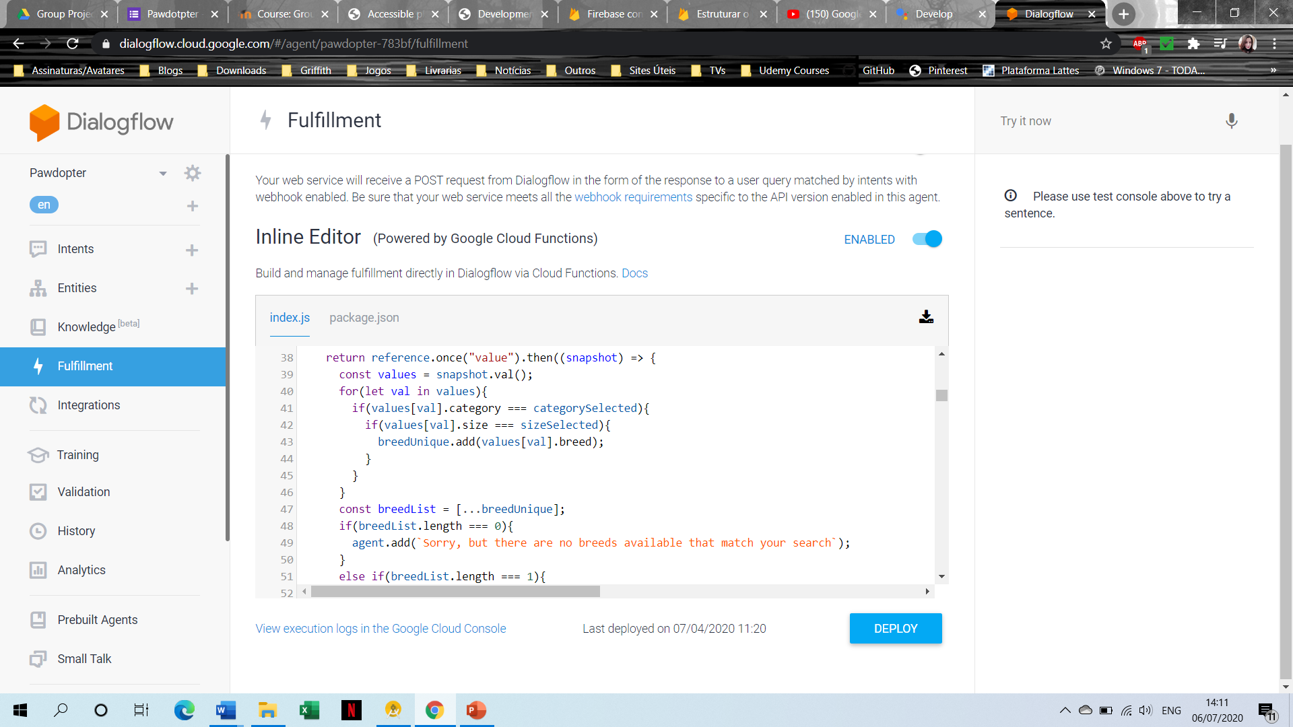
Connecting Firebase Database with IoT Home device (Actions on Google Home Assistant)

Slide 24
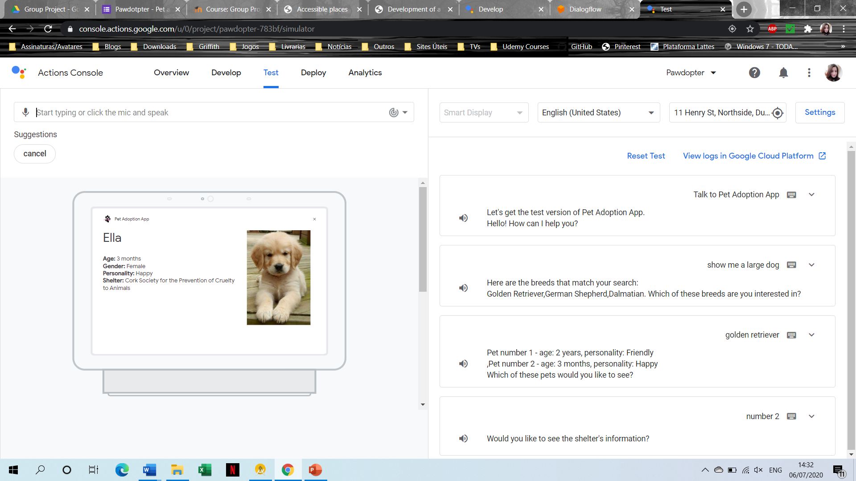
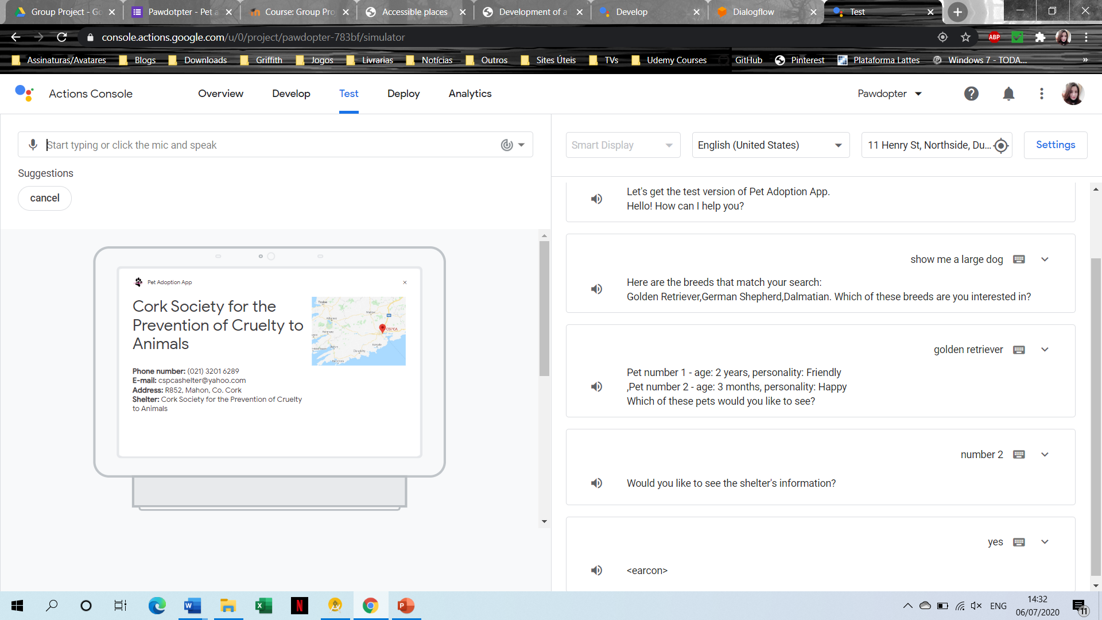
Connected Mobile App with Google Home Assistant (Firebase Database and Actions on Google Home Assistant)

Slide 25
Testing
White-Box Testing | Black-Box Testing | Grey-Box Testing
Tests the internal structure, the design and implementation of the solution; Inputs are chosen by the tester; Can start at an early stage; It is very thorough process and covers most application paths; Needs highly skilled personnel; Can be a burden, since changes are too frequent; Expensive process. | Tests the behaviour/functionalities; Structure, design and implementation of the software are not known by the tester; Works a black-box in the eyes of the tester; Done from the users’ point of view; No need for programming knowledge; Can leave program paths untested; Difficult to design testing cases if there are no clear specifications; Redundancy. | Black- and White-box testing combined; Internal structure is known firstly to design test cases; Test is done from the users’ point of view; No need for high programming knowledge; Unbiased; More effective in integration testing Not exhaustive; Ideal for projects with limited time frame.

Slide 26
Testing Cases
Action | Expected result | Pass | Fail | Actual result
Open application | Initial screen opens if user has not registered and logged in, otherwise main screen opens |  |  | Initial screen is displayed if user has not registered and not logged in. Main screen is displayed otherwise
Select Register option | Registration screen opens |  |  | Registration screen is displayed
Register button pressed without any data entered | Display error message to enter data for each field |  |  | Error message is displayed in each field, asking user to enter data
Register button pressed when invalid data is entered | Display specific error message to each field where data is invalid, guiding the user on how to fix it |  |  | Specific error message is displayed to each field where data is invalid, guiding the user on how to fix it
Register button pressed with valid data entered in all fields | Create new user and open main screen |  |  | New user is created, and main screen is displayed
Select Login option | Login screen opens |  |  | Login screen is displayed
Login button pressed without any data entered | Display error message to enter data |  |  | Error message is displayed in each field, asking user to enter data
Login button pressed when invalid data is entered | Display specific Toast message, regarding the error |  |  | Specific Toast message regarding the error is displayed

Slide 27
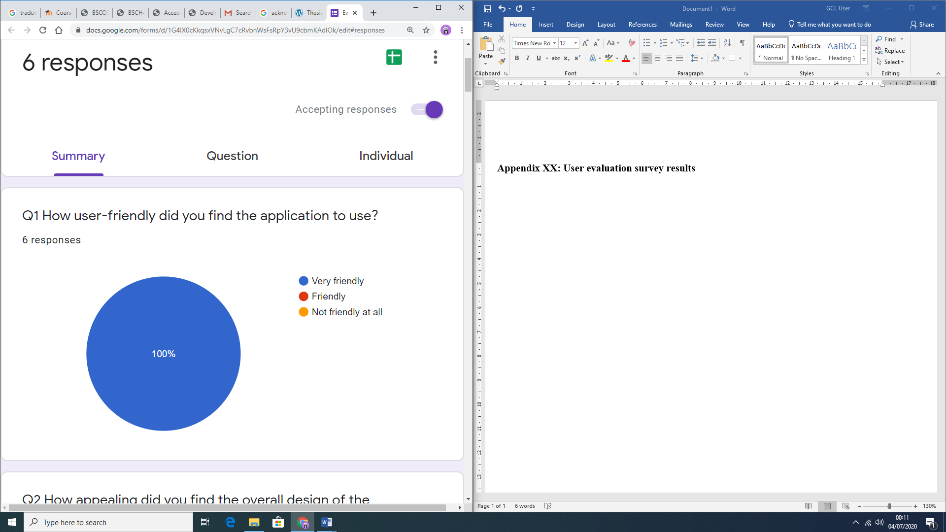
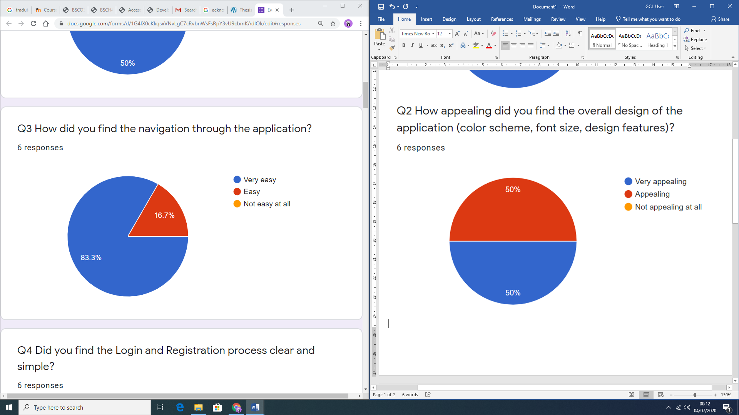
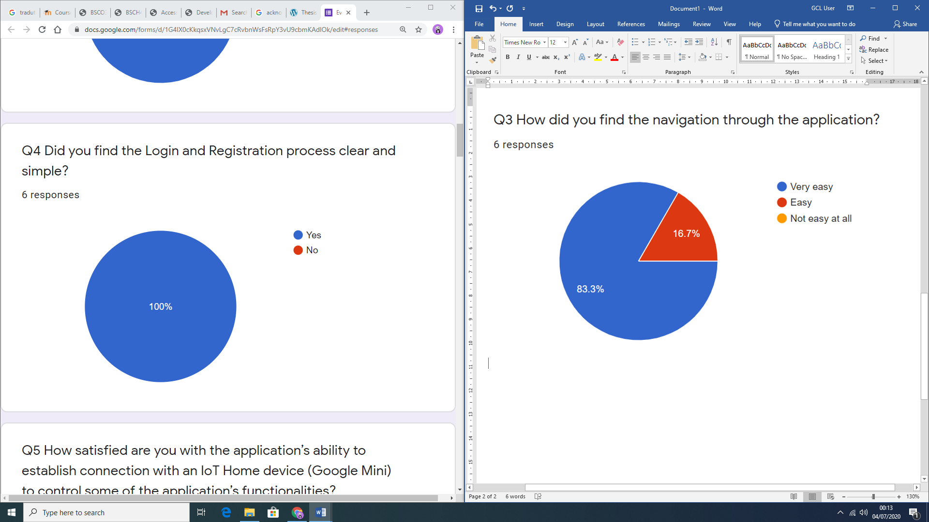
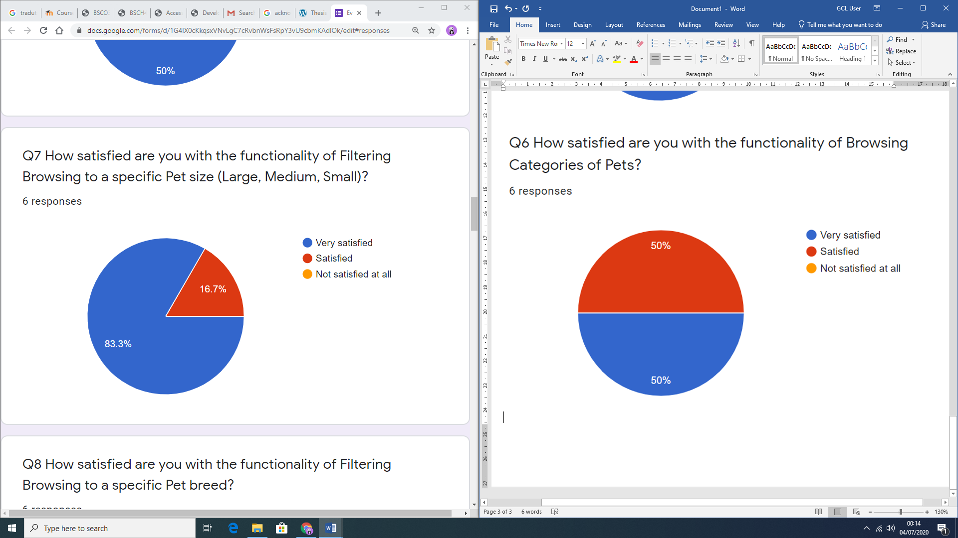
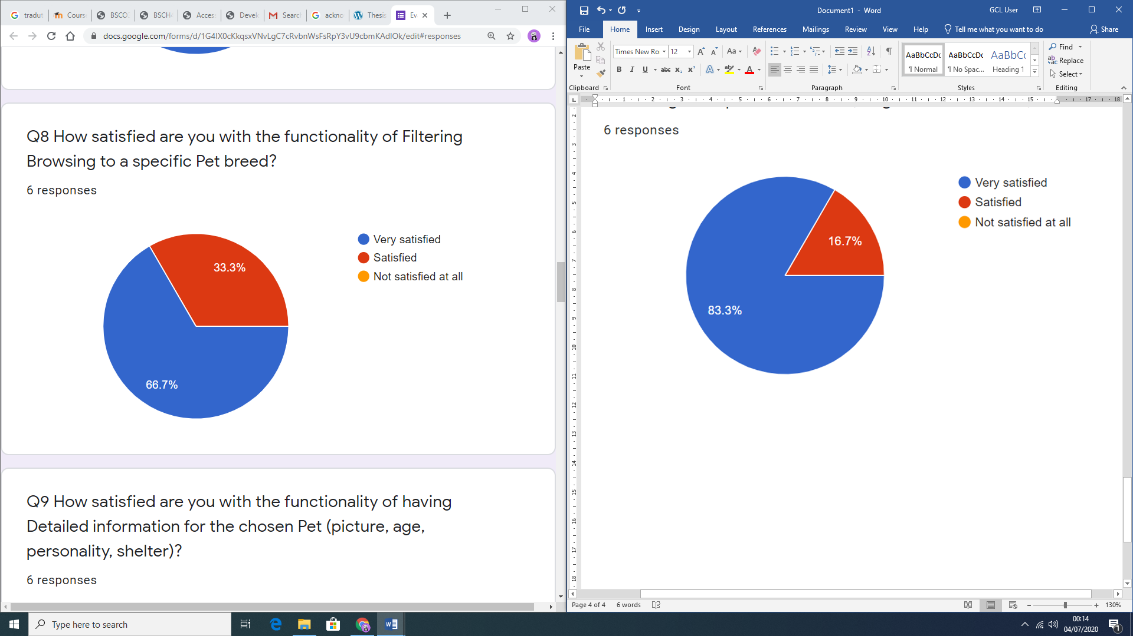
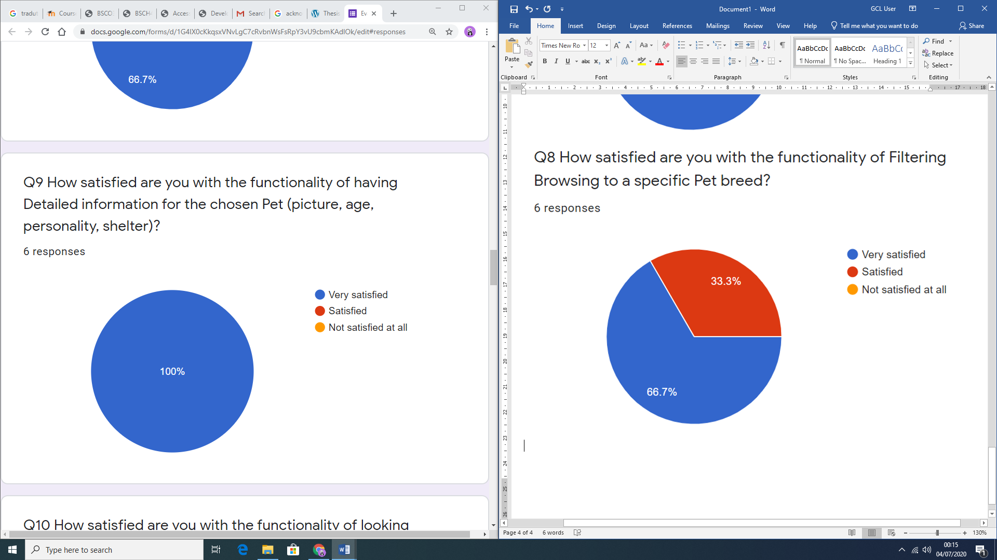
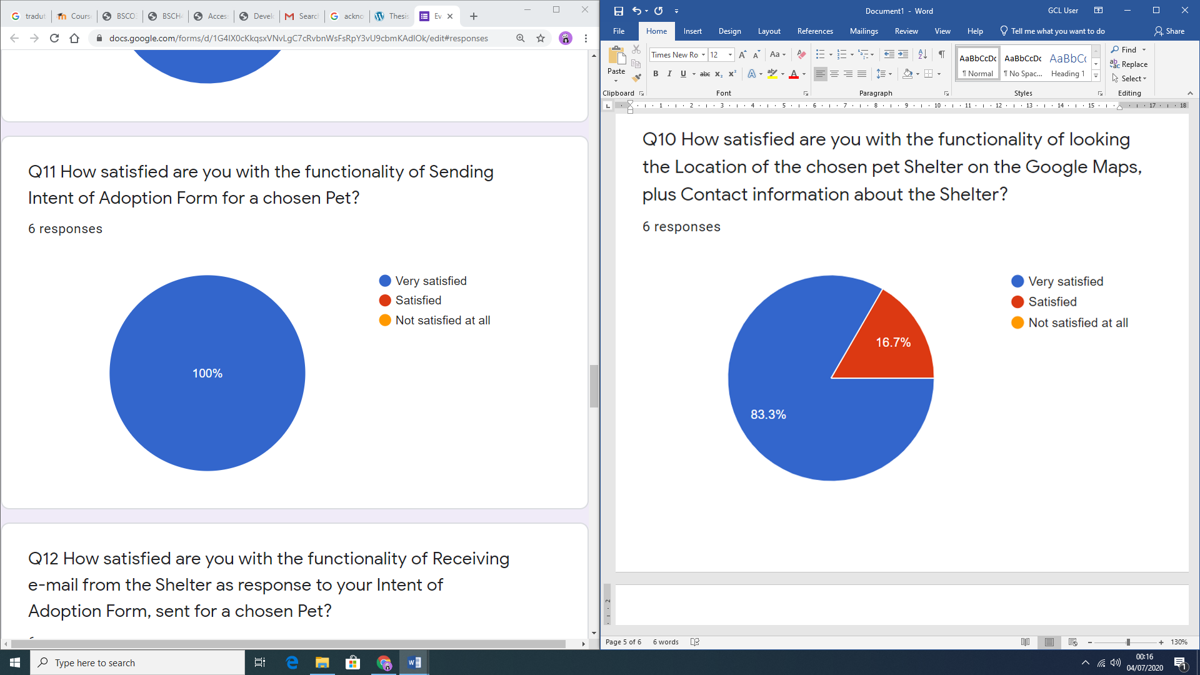

Project Evaluation
Google Forms Tool
Survey with 6 Participants, all owning Google Home Assistant IoT device
Performed within a week
Very positive feedback

Slide 28
Project Achievements
A Project Proposal was created, based on the performed initial Literature Review (Secondary research) on the topic;
Primary (Quantitative) research with Survey Questionnaire was performed;
The results obtained from the Survey were critically analysed and application requirements were specified in a Conceptual Model for the application;
Using Storyboarding process, the Graphical User Interface for the application functionality was designed, together with appropriate data structures;
Coding and thorough testing of the designed application was performed, as well as its integration with the Google Home IoT device;
The application was then evaluated by potential adopters, who were owning Smart Home (IoT) device (Google Home Assistant);
The Thesis document was completed with Conclusions and Scope for Future work on the project.

Slide 29
Contributions to IT field and Society
Development of a functional mobile application as a searching tool, integrated with Google Home Assistant IoT device for potential animal adopters to easily find the desired pet to be loved;
Simplified searching engine to find a pet;
Application developed to industry acceptable standards, and integrated with Smart IoT device, achieving all Project objectives within the Project’s granted timeframe.

Slide 30
Personal and Professional Achievements
Working as part of a team;
Time management skills;
Project development and management skills;
Overcoming unexpected fall-backs;
Applying theoretical knowledge into a real world project;
New development platforms;
Share and delegate responsibilities;
Help colleagues and share obtained information;
Ability to provide alternative solutions when the planned one is not working

Slide 31
Conclusions
Functional Application was developed with suitable interface for potential animal adopters
Extremely positive feedback was obtained from the performed User Evaluation Survey.
Benefits of this project are high for both shelters and potential animal adopters, but most importantly - for the pets, to increase the adoption rate and effectiveness of finding desired pet faster and easier.

Slide 32
Scope for Future work
Develop shelters’ interface;
Develop the High-end solution to include a chat box between potential adopters and the shelter workers;
The filters not to be nested, except for the category and breed;
Users’ password not to be stored in the application’s database, but with the Firebase Authentication platform, to improve the security of the application.

Slide 33
User Manual
Application’s View:
Open the application
Login
Registration
Login
Fill in email and password
Registration
Fill in name, Mobile Number, Email, Password
Filter the pets through Category, Size and Breed
Forgot password
Fill in email registered
Update details
Changeable information: mobile number and password
Send intention of adoption form for selected animal
Click on shelter’s name to see detailed information of the shelter
Google Assistant’s View:
Call Hey Google, Talk to Pet Adoption app
Use commands to find the pet
I’d like to adopt a cat;
I want to adopt a large dog;
I would like a dog;
Provide the inputs asked by the Google Assistant

Slide 34
Thank you!
Any Questions?

